Slide 1
Linux
Final PRESINTATION
Tabatha Mitchell
2/21/2024

Slide 2
Introduction
Linux is very popular operation system that many corporate companies use.
Many cybersecurity professionals use Linux for security and penetration assessments.
Many database servers and web servers run on Linux.

Slide 3
Linux File System
Navigate the Linux filesystem
Create directories and files
Copy and remove directories and files
Locate directories and files

Slide 4
Navigate the Linux filesystem tree
1. What is the pwd command an acronym for? What about the cd command?
pwd-Print working directory- shows our current location in the file structure.
cd- change directory- navigate to another file in a file structure.
2. Explain the differences between a relative path and an absolute/full path in Linux.
Relative path- is based on where you are in a file structure.
Absolute- the very beginning of a file system

Slide 5
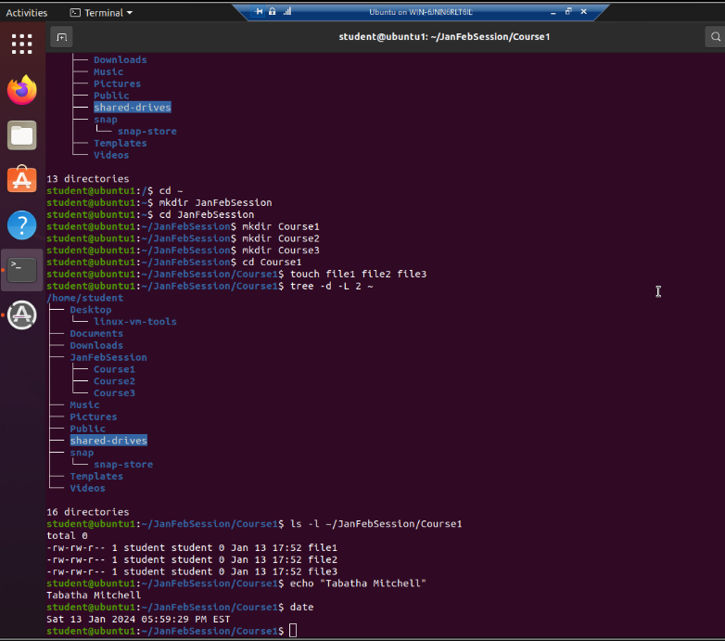
Create directories and files

Slide 6
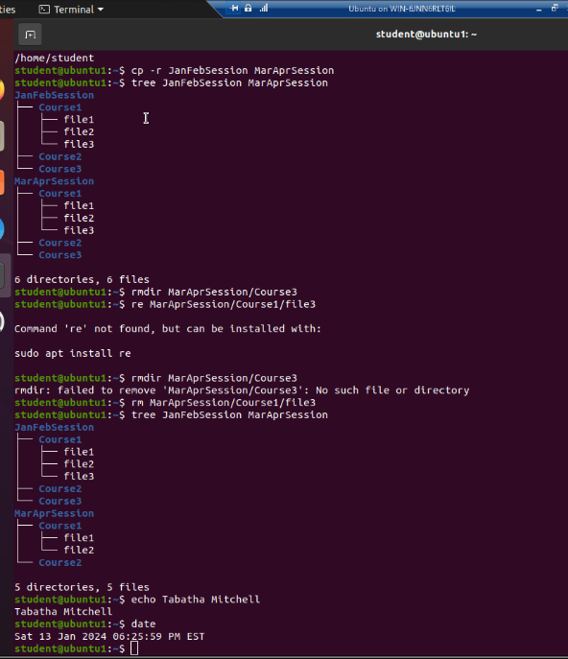
Copy and remove directories and files

Slide 7
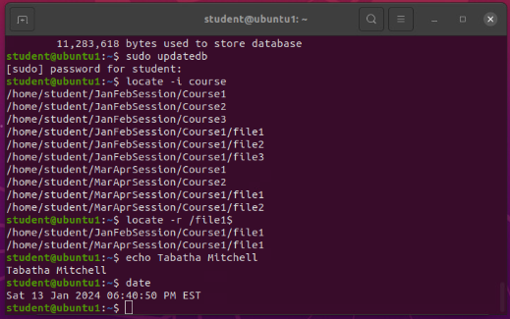
Locate directories and files

Slide 8
Script and PATH
Create a shell script
Setting file permissions
Setting PATH variable
Make the PATH variable permanent

Slide 9
Create a shell script
1. What are the file permissions of the script?
rw-rw-r (664)
First rw- means read and write only for the user and the second rw- is only for group members.
The last r means read only for everyone else
2. What’s the name of the user-defined variable in the script?
text
Read text means read from the user and put input into variable called text.
3. Which redirection meta-character is used in the script? What does it do?
“>>” and it appends the output in a file

Slide 10
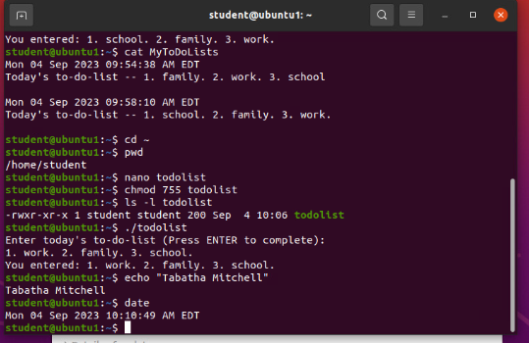
Change script file permissions

Slide 11
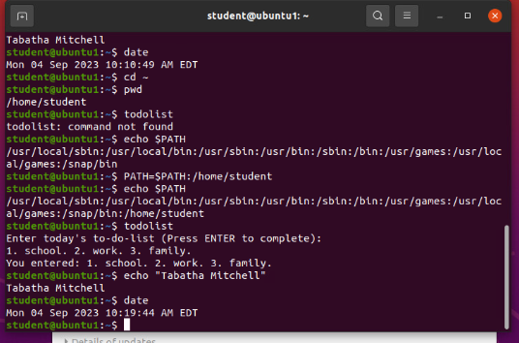
Set the PATH variable

Slide 12
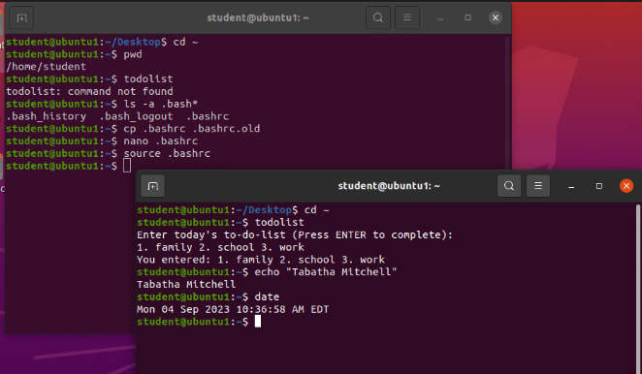
Make the PATH variable permanent

Slide 13
Users and groups
Add users and groups in CLI
Test user and group settings
Add users in GUI
Remove users and groups

Slide 14
Add users and groups in CLI
1. What does the –m option in the useradd command do?
create it in the home directory.
2. What does the -3 option in the tail command do?
gives you the last three lines of the file.
3. Which line of the /etc/group file lists members of the “students” group?
students:x:1002:student,mary

Slide 15
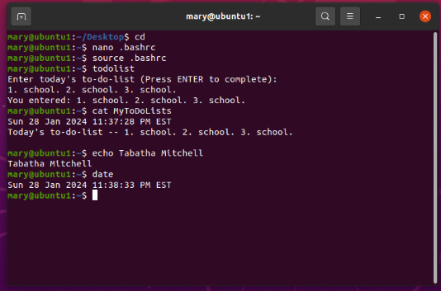
Test user and group settings

Slide 16
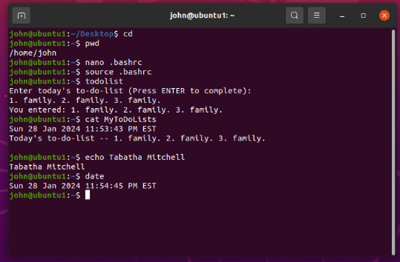
Add users in GUI

Slide 17
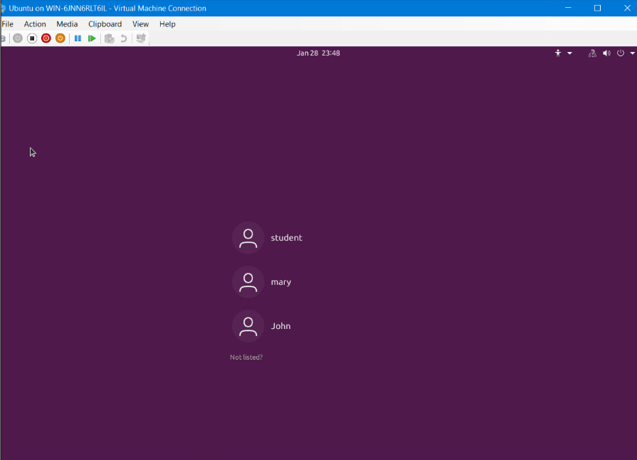
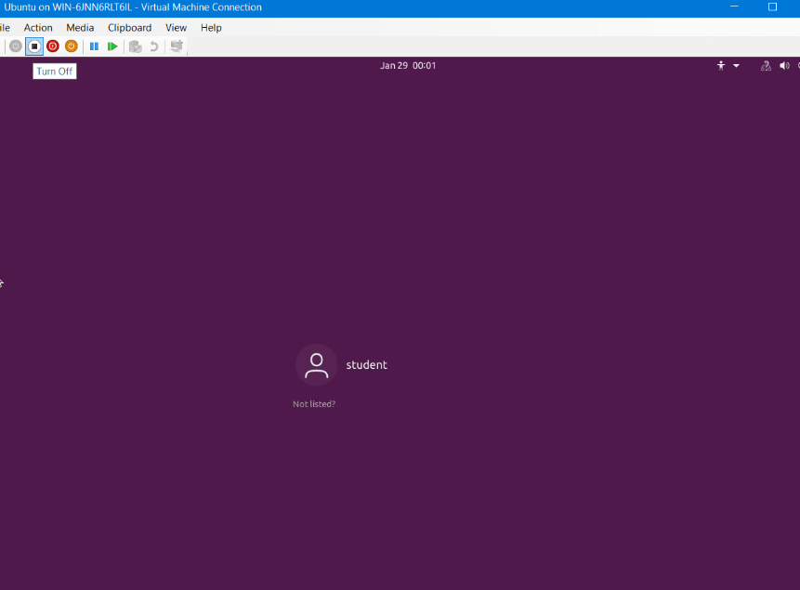

Remove users and groups

Slide 18
Ip address and Networks
Discover host IP configurations
Manage network interfaces
User network utilities

Slide 19
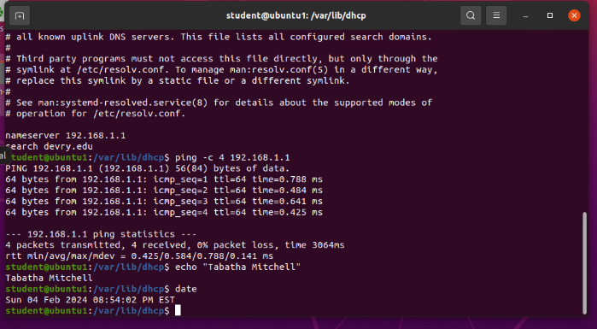
Discover host IP configurations
1. What is the IP address of your Ubuntu machine?
192.168.1.107
2. What is the IP address of its default gateway?
192.168.1.1
3. What is the IP address of its DHCP server?
192.168.1.1
4. What is the IP address of its DNS server?
192.168.1.1
Take a screen capture of the output in Step 12.

Slide 20


Manage network interfaces
1. Which DHCP message is shown in the output of the sudo dhclient –v –r eth0 command?
killed old client process and it disconnected Ip address 192.168.1.108
2. Which four DHCP messages are shown in the output of the sudo dhclient –v eth0 command?
I get everything back including IP address 192.168.1.108

Slide 21
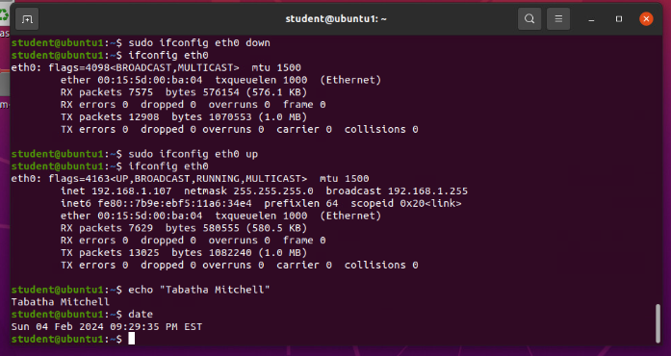
Use network utilities

Slide 22
Monitoring
Monitor processes
Monitor user activities
Monitor network bandwidth usage

Slide 23
Monitor Linux processes
1. What is the default action of the 15 SIGTERM kill signal?
requesting a graceful shutdown of the process or sending a kill signal to process
2. In the System Monitor window, click on % CPU to sort the processes by CPU load. Which process shows the highest percentage of CPU usage?
GNOME shell was taking around 7% of the CPU.

Slide 24
Monitor user activities
Issue the sudo accton on command to turn on GNC accounting. Run the sudo updatedb command. Enter lastcomm updatedb to check if the updatedb command was executed before. Remember to turn off GNC accounting (sudo accton off) after answering the questions.
1. What flag value is displayed in the output?
The S flag for super user
2. Why is the name of the user who ran the processes shown as root, not student?
It is showing the user root because we executed the updated command with the sudo command.

Slide 25
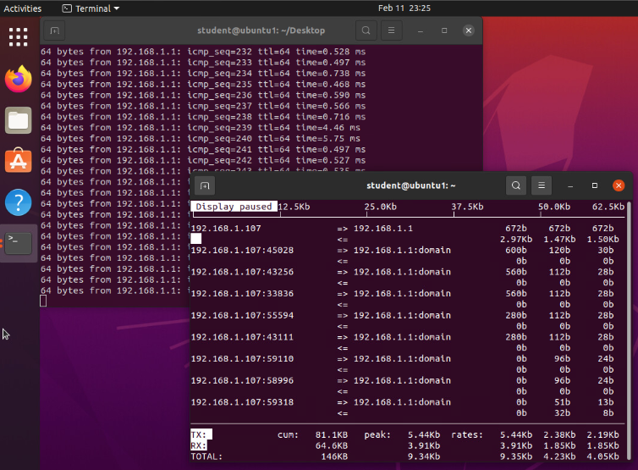
Monitor network bandwidth usage

Slide 26
Challenges
Learning the commands
Case sensitivity

Slide 27
Career skills
Administering an operating system
Writing simple Bash script files (automation)
Working with group file/ directory permissions

Slide 28
conclusion
Linux is a fun operating system to use
Linux is very stable
Linux is reasonably priced

