Slide 1
SEC285
Final
By: Tabatha Mitchell
04/26/2025

Slide 2
Content
Asymmetric Key Encryption
  File Encryption
  File Decryption
Stateful Firewall
  Nmap Scan
  sudo iptables --policy INPUT DROP
Bring Your Own Device (BYOD)
Security Policy
Multifactor Authentication (MFA)
  Common-auth Configuration File
  MFA Logon Screen
Vulnerability Assessment
  Nmap
  NetCat
  Wireshark
  Nessus

Slide 3
Introduction
In the SEC285 class, we covered key topics in cybersecurity and network security, including asymmetric key encryption for secure communications and file encryption methods to protect sensitive data. We explored the functionality of stateful firewalls, practiced using Nmap for network security assessments, and configured firewalls with the command `sudo iptables --policy INPUT DROP`. We also reviewed the Bring Your Own Device (BYOD) Security Policy for managing personal devices at work and looked into setting up multifactor authentication (MFA). Finally, we conducted vulnerability assessments using tools like Nmap, NetCat, Wireshark, and Nessus.

Slide 4
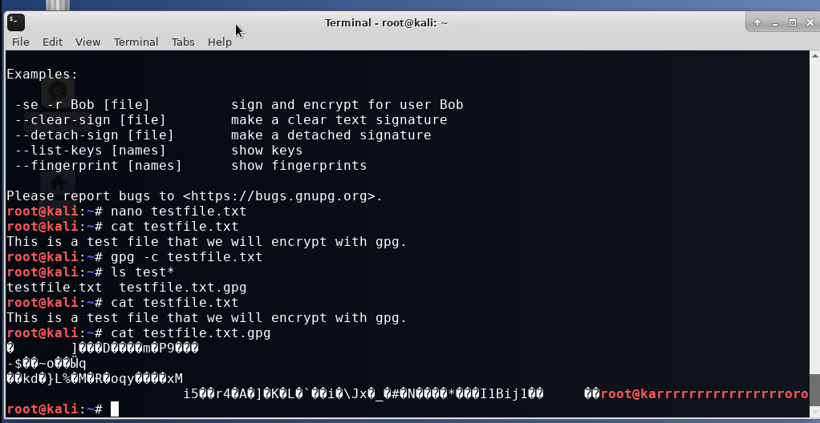
File Encryption
This screenshot displays the following:
• The content of the plaintext file
• The content of the encrypted file

Slide 5
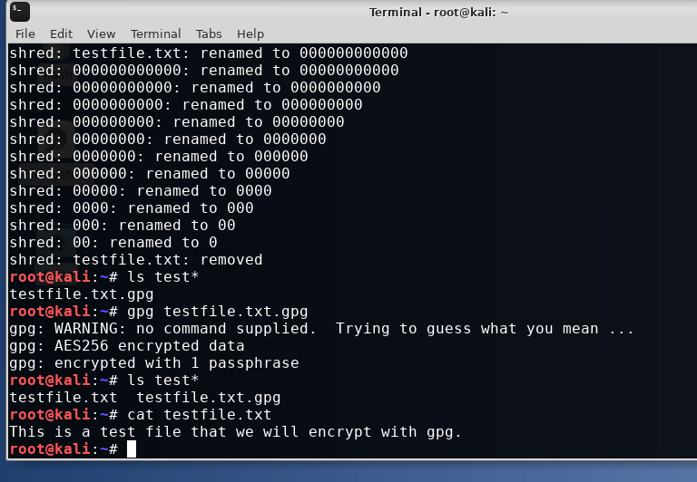
File Decryption
This screenshot displays the following:
• The encrypted file listed individually
• The decryption process
• Both the encrypted file and the original plaintext file displayed

Slide 6
Question
What effect does the sudo iptables --policy INPUT DROP command have on the access to computing resources?
Answer here:
The command `sudo iptables --policy INPUT DROP` blocks all incoming traffic that does not match specific rules, which improves security. You must create rules to allow legitimate connections like web or SSH access. If you don't, important services may not be reachable. Monitoring dropped packets can help you spot threats, so it is important to balance security with accessibility.
References:

Slide 7
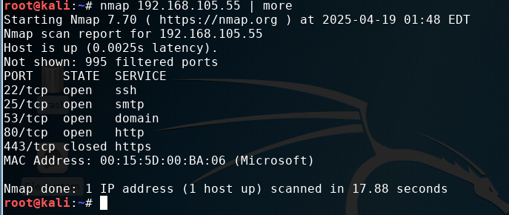
Nmap Scan
This screenshot should show the Nmap scan result of the Linux Server VM.

Slide 8
Overview:
Tablets, smartphones, and laptops are essential for modern businesses. They help employees work and communicate better, whether in the office or remotely. However, these devices also have security risks. They can get malware, and sensitive data can be lost or stolen. Unsecured networks can expose them to hackers. Personal devices can make security management harder. To protect information, businesses should use effective device management and train employees regularly.
2. Purpose:
The main goal of any IT security policy is to protect data by ensuring its confidentiality, integrity, and availability (CIA). A key reason for having a Bring Your Own Device (BYOD) security policy is to find devices that create extra risks for the organization’s computing resources. When organizations quickly spot these vulnerabilities, they can take action to fix them before attackers exploit them. This quick identification helps reduce the number of entry points for attackers. By closing these gaps, organizations make it tougher for criminals to access their systems. The sooner vulnerabilities are addressed, the less time attackers have to take action, which helps keep sensitive information safe. Knowing which devices are allowed and their security status further strengthens an organization’s defenses against potential breaches.

Slide 9
3. Scope:
The use of personal devices on the network is often subject to specific guidelines and approvals to ensure security and compliance. Typically, devices such as laptops, smartphones, tablets, and smartwatches may be allowed, provided they adhere to designated security standards and are used for work-related purposes during established hours. Personnel must usually receive formal approval from the IT department before connecting their personal devices to the network, which involves registering the device and ensuring it meets necessary security protocols. Allowed activities on these personal devices generally include accessing work-related applications, corporate emails, and communication tools, while recreational use may be restricted, especially if it involves handling sensitive data. Ultimately, the responsibility for granting permission to use these devices lies with the IT or network security team, who assess each device for compliance with company policies before permitting access to the network.
4. Policy:
At ABC Corporation, employees must complete security assessments for their personal devices (BYOD) to access the corporate network, which requires meeting specific security standards. Devices must run operating system X, be updated with the latest patches, have current antivirus software, and a properly configured firewall. Owners of noncompliant devices must resolve any issues, with assistance available from the IT department. Until devices meet these requirements, they will not be allowed on the network. Compliant devices must adhere to safety, performance, and environmental standards, following electromagnetic compatibility (EMC) guidelines and regulations like RoHS. Additionally, they must pass testing, include clear documentation, and display certification marks such FCC compliance in the U.S.

Slide 10
5. Policy Compliance:
The InfoSec team is crucial for ensuring compliance with security policies through methods like periodic walkthroughs, video monitoring, and intrusion detection tools. To promote adherence, organizations should hold regular training sessions, provide clear channels for questions, and conduct frequent compliance checks. Recognizing and rewarding compliance, along with establishing clear procedures and a confidential reporting system, can strengthen this effort.
Non-compliance can result in disciplinary actions, including warnings or termination, and may increase security risks like data breaches. Assigning individuals to oversee compliance fosters accountability. This framework is vital for maintaining a secure environment and emphasizes the importance of adhering to security protocols.
6. Related Standards, Policies, and Processes:
Several important documents relate to this policy to improve compliance and security. First, HIPAA protects patient information in healthcare and ensures confidentiality. Next, PCI-DSS safeguards credit card data during payment processing. The NIST Cybersecurity Framework offers guidelines for managing cybersecurity risks. ISO/IEC standards help improve information security management. If applicable, GDPR is important for organizations working with personal data in the EU. Finally, company-specific security policies explain procedures and responsibilities. Together, these documents build a strong framework that supports compliance and enhances information security.

Slide 11
7. Definitions and Terms:
1. BYOD means Bring Your Own Device. This policy lets employees use their personal devices, like smartphones and laptops, for work. It offers flexibility but can create security risks.
2. Mobile devices are portable electronics, including smartphones and tablets. They allow users to access information and communicate while on the go.
3. CIA stands for Confidentiality, Integrity, and Availability. This is a principle of information security. It means keeping data private, accurate, and accessible to authorized users when needed.
8. Revision History:
Date of change | Responsible | Summary of change
August 2019 | SANS policy team | Updated and converted to new format
April 19, 2025 | Tabatha Mitchell | Updated

Slide 12
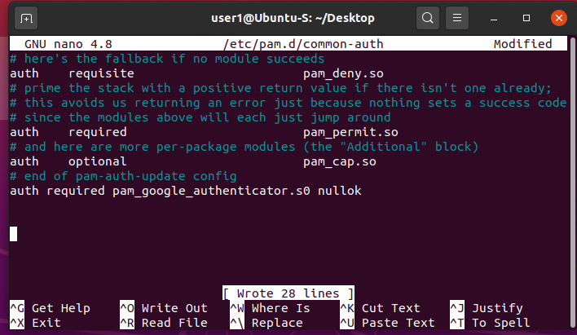
Common-auth Configuration File
This screenshot should show the entry that indicates the use of the Google Authenticator module.

Slide 13
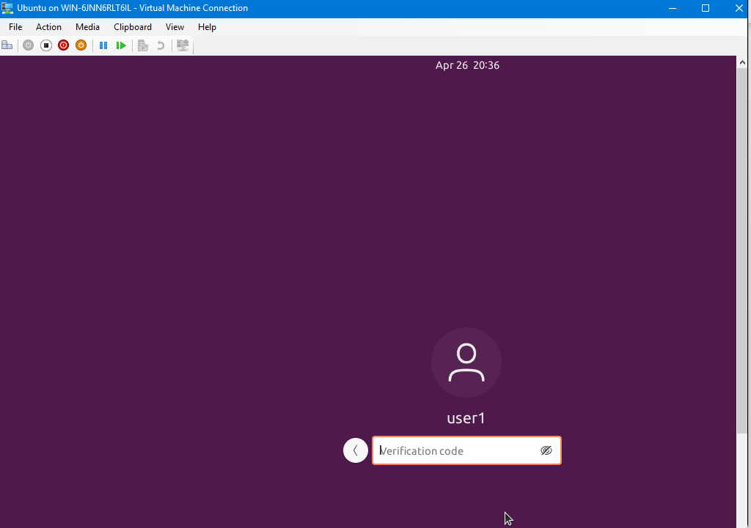
MFA Logon Screen
This screenshot should show the logon screen where a verification code is required.

Slide 14
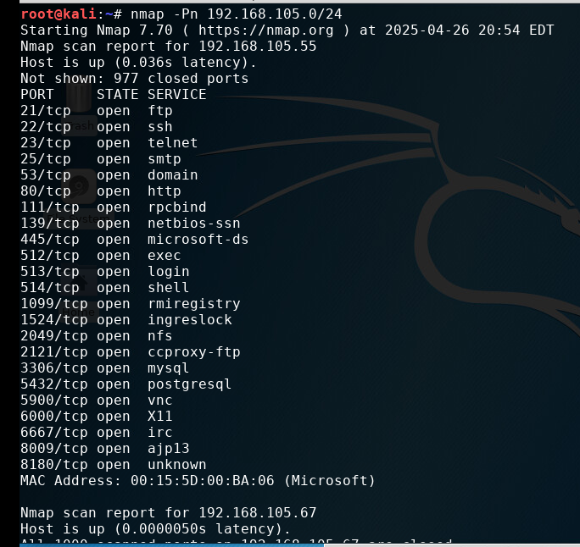
Nmap
This screenshot should include the scan result showing both the Kali and Linux Server VMs.

Slide 15
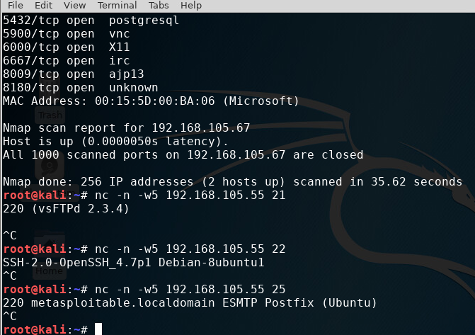
NetCat
This screenshot should include the scan result showing both the Kali and Linux Server VMs.

Slide 16
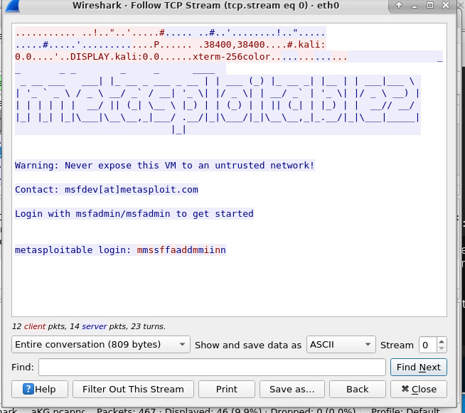
Wireshark
This screenshot should include the Wireshark—Follow TCP Steam window showing the Telnet username and password.

Slide 17
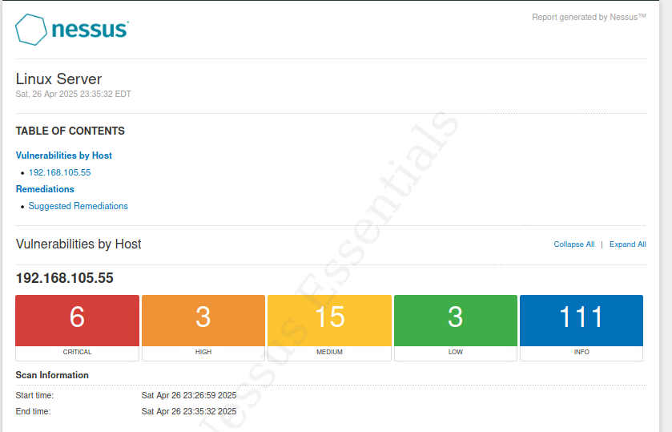
Nessus
This screenshot should include the high-level view of the Nessus vulnerability scan report (showing categories of vulnerability in different colors).

Slide 18
Career Skills
Cybersecurity Knowledge
Network Security Assessment
Firewall Configuration
Risk Management
Analytical Skills
Technical Proficiency

Slide 19
Conclusion
the lessons in this class provided a clear overview of cybersecurity practices and tools. We learned how to secure data, configure firewalls, and assess vulnerabilities, which prepares us to protect networks and sensitive information. These concepts help us understand the importance of strong security measures in today's digital world.

