Slide 1
Introduction to Programming
By: Tabatha Mitchell

Slide 2
Introduction
The amount of data is increasing rapidly.
This project utilizes a cloud-based system for collecting temperature and humidity data.
The data undergoes analysis using programming and data analytics as part of the process.

Slide 3
Software Inventory
Before starting this programming and data project, I downloaded and installed all the necessary software.
The required software includes Excel and Python.

Slide 4
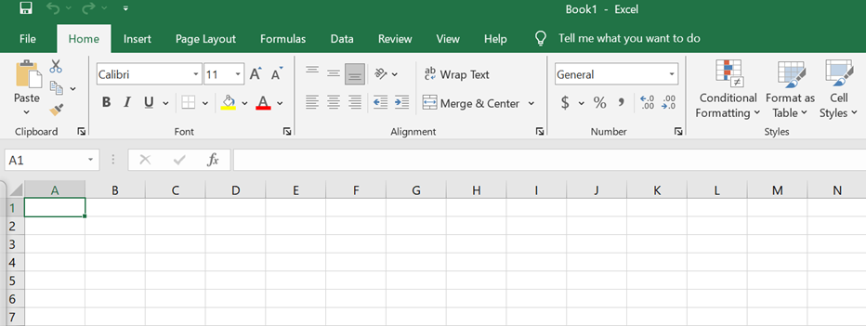
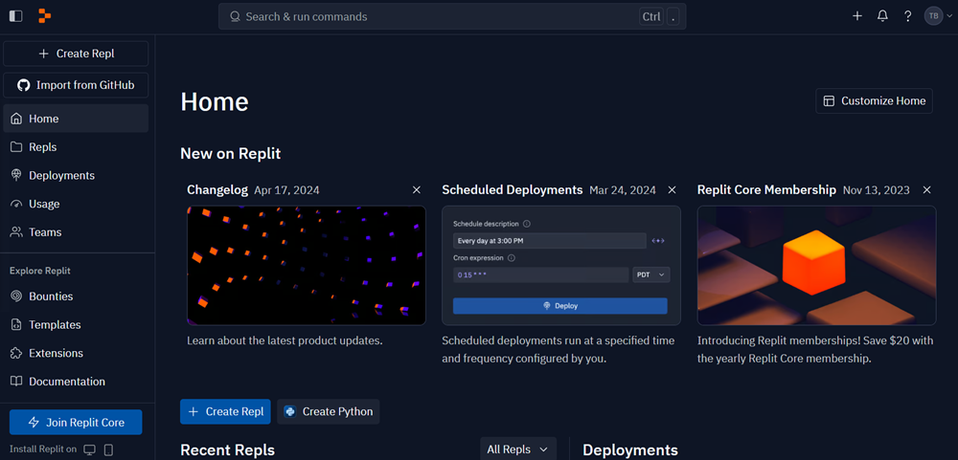
Software
The software used for these projects included:
Microsoft Excel
Replit

Slide 5
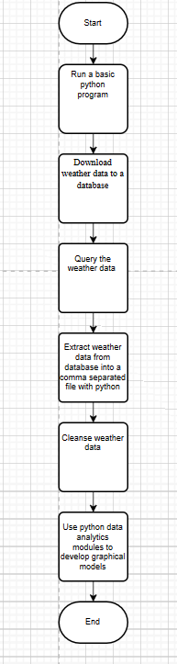
Flowchart
Include the following processes:
  Run a basic Python program
  Download weather data to a database.
  Query the weather data
  Extract weather data from database into a comma separated file with python
  Cleanse weather data
  Use python data analytics modules to develop graphical models

Slide 6
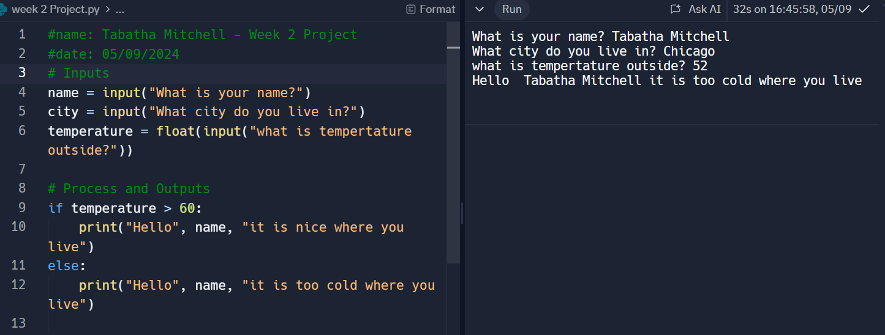
Python program
(Screenshot)
Include screenshot of successful python program

Slide 7
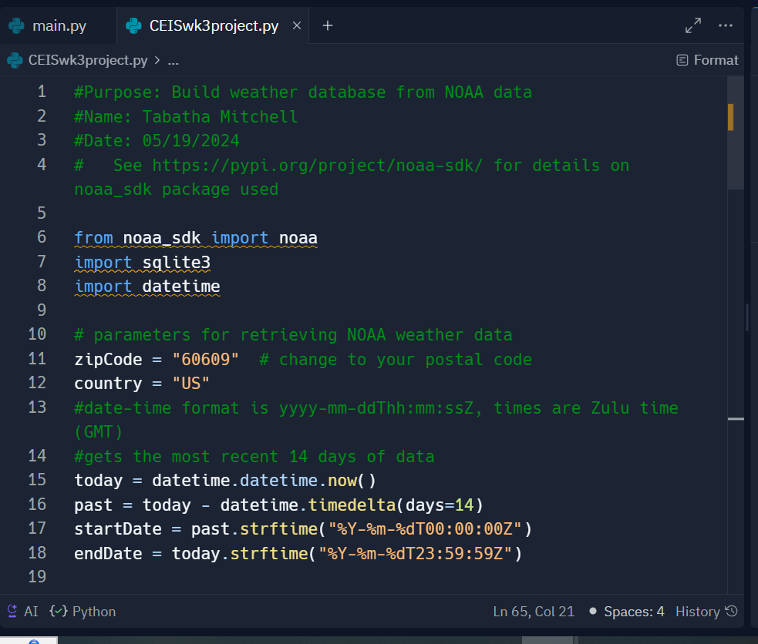
BuildWeatherDb.py Code (Screenshot)
Screenshot of code in Replit

Slide 8
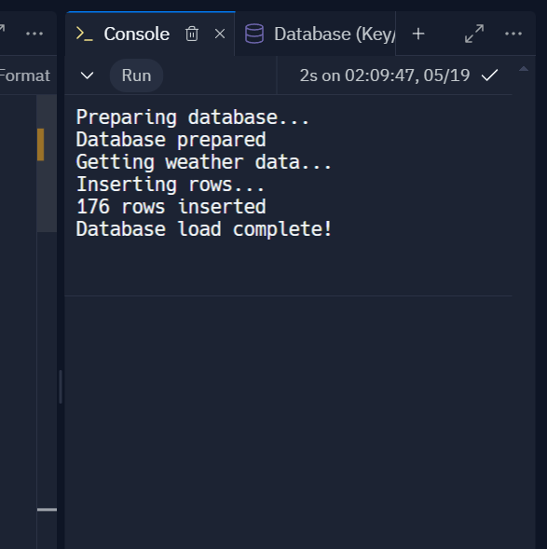
Python Console
(Screenshot)
Screenshot of program output in Python console showing program executed successfully

Slide 9
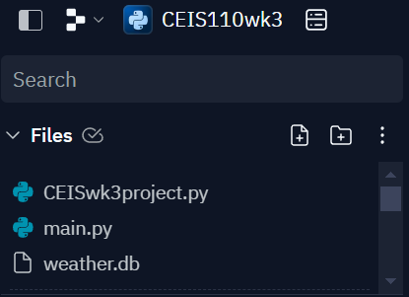
Weather.db File
(Screenshot)
Screenshot of Windows Explorer showing database file Weather.db was created

Slide 10
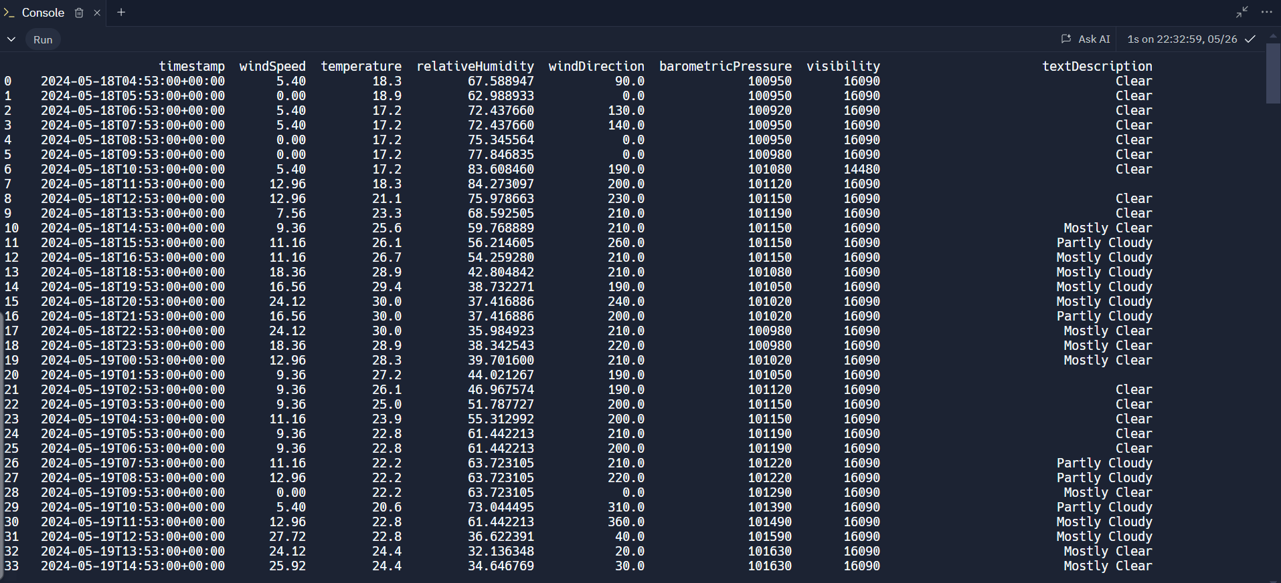
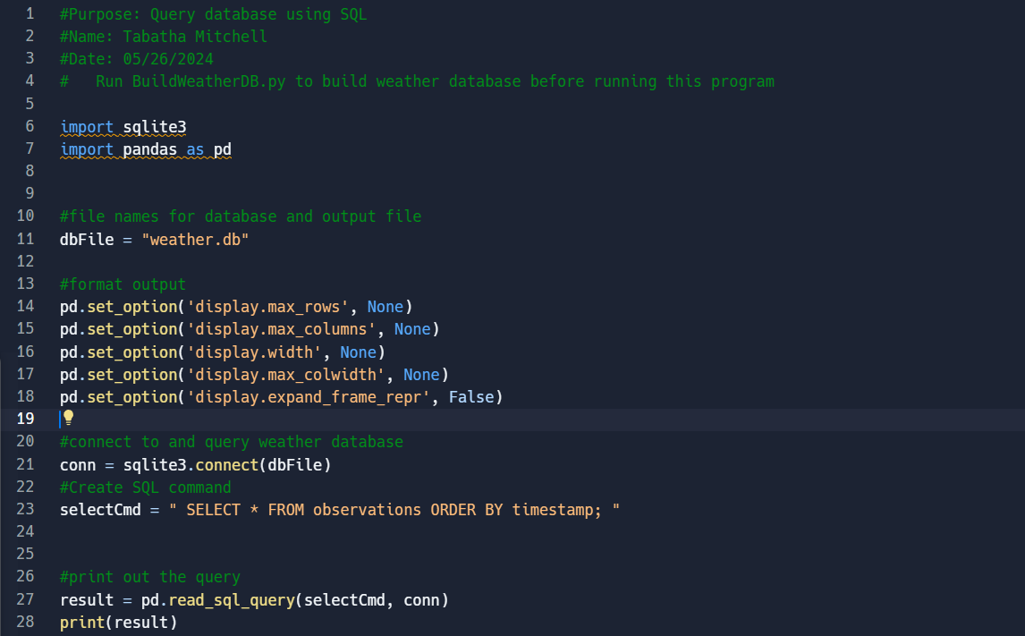
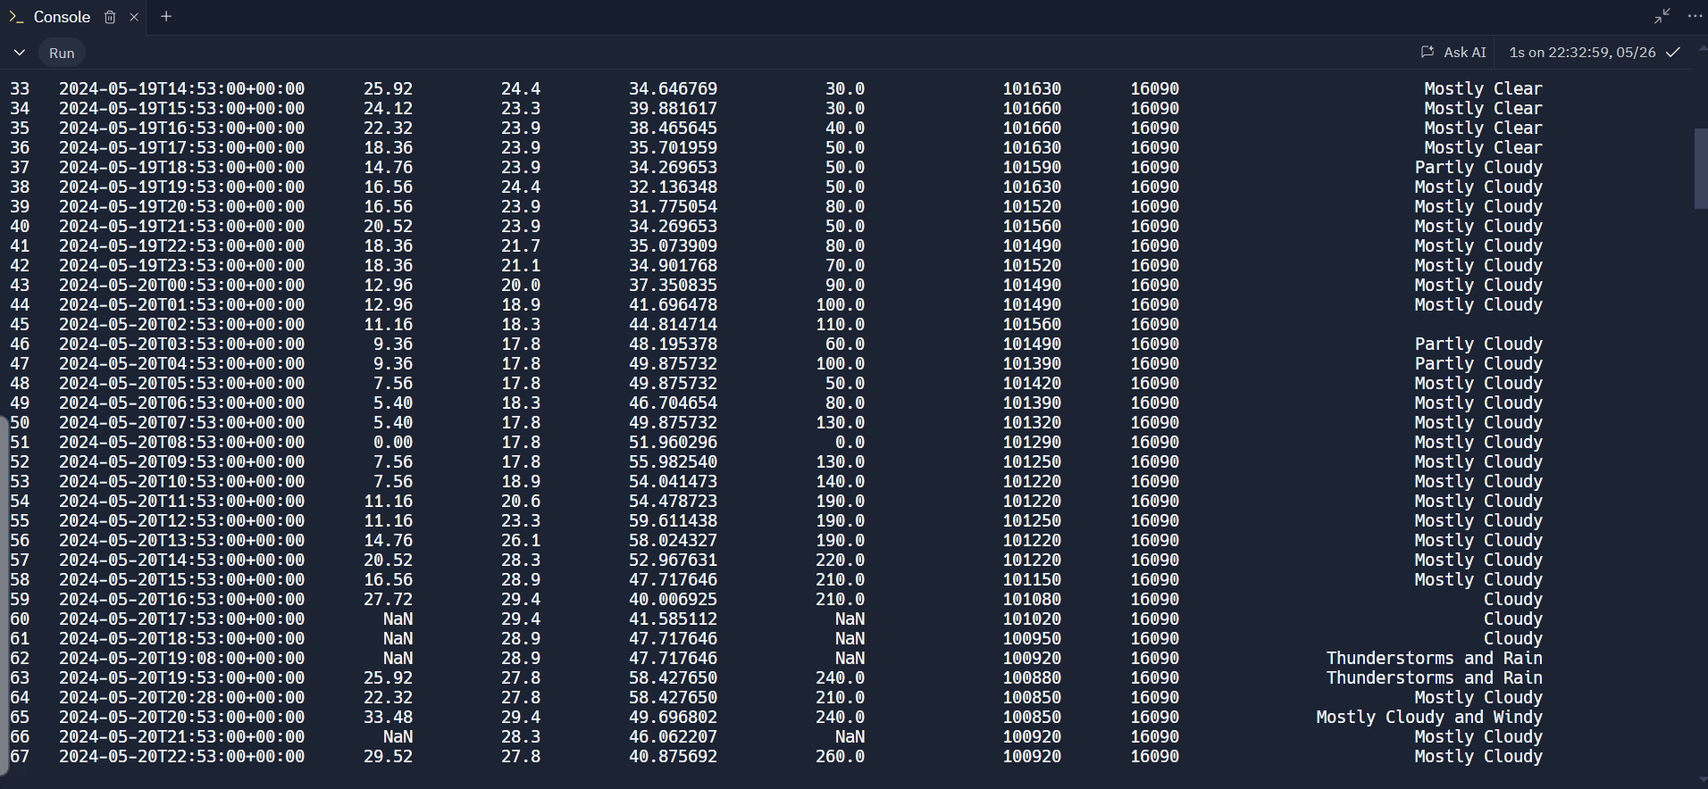
Weather database from Chicago, Illinois
Query database using SQL command and results. More results on next page

Slide 11
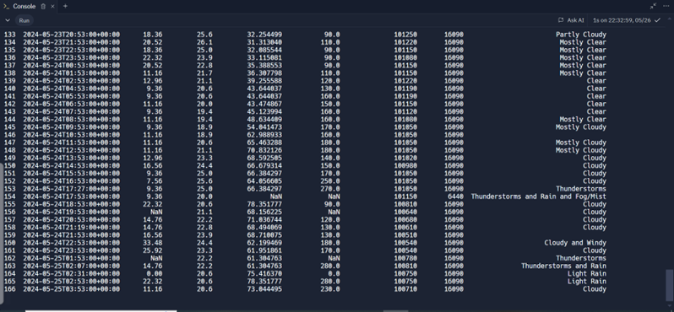
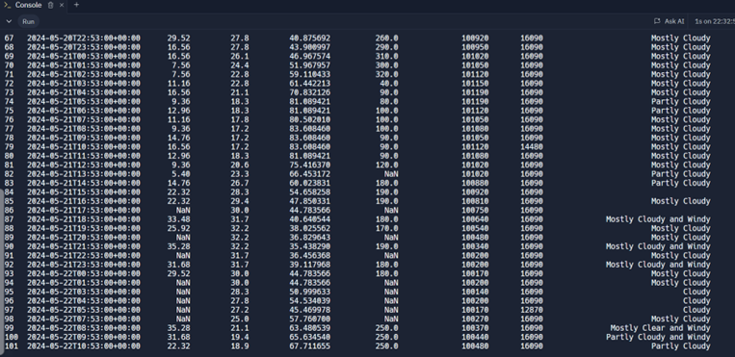
Screenshot of SQL query continuing of results

Slide 12

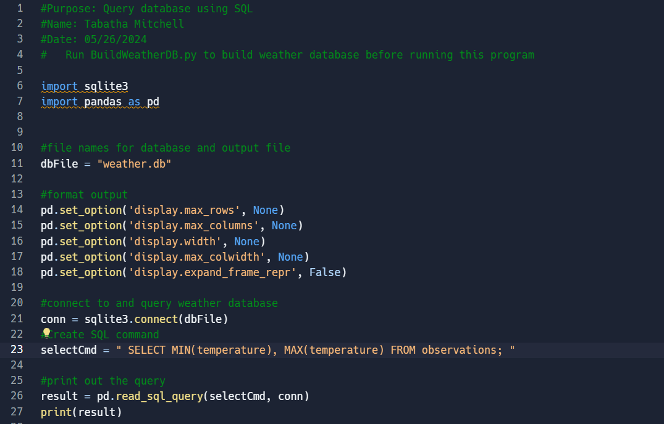
Query to retrieve lowest and highest temperatures
(Screenshot)
Screenshot of SQL query command and results

Slide 13
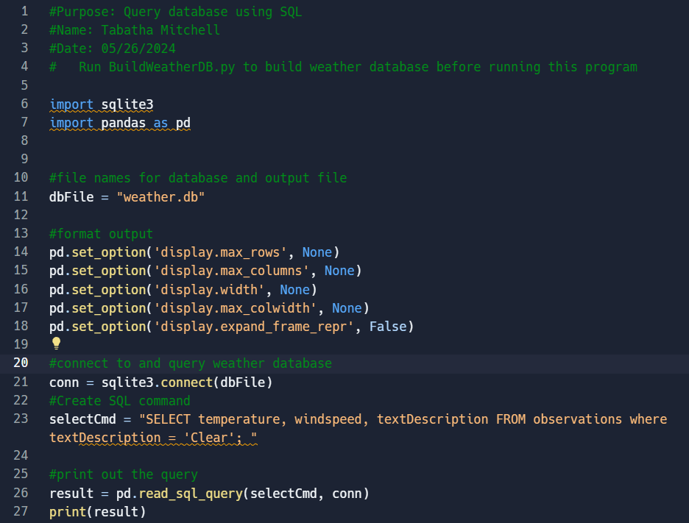
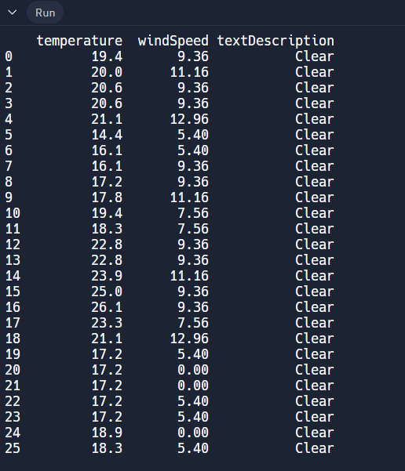
Query to retrieve all clear days
(Screenshot)
Screenshot of SQL query command and results

Slide 14
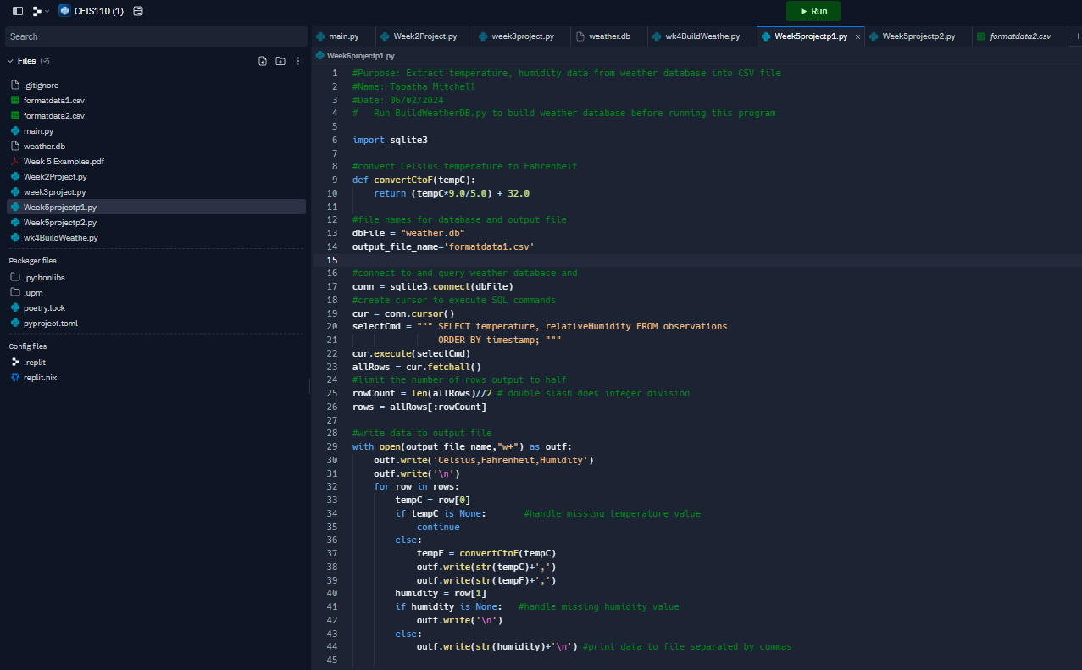
Python code (Screenshot or file)
ExtractTempHumidity.py Python code with your name and date in comments

Slide 15
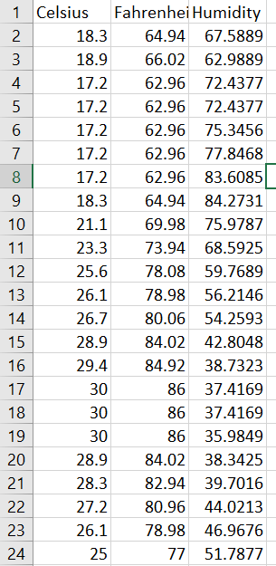
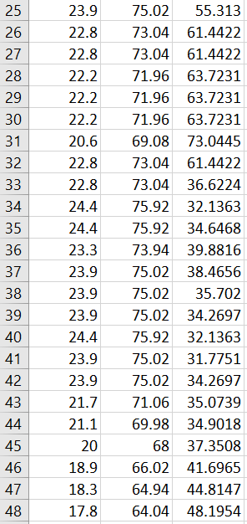
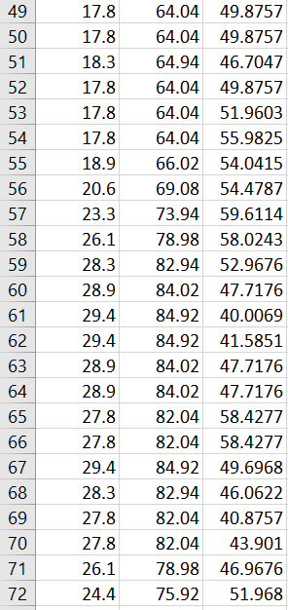
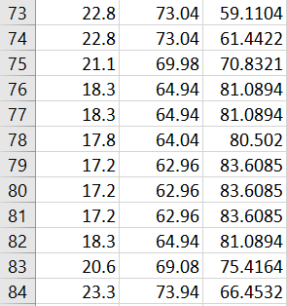
Retrieve and Convert Data to CSV Format (Screenshot)
Formatdata file open in Excel showing 3 columns of data

Slide 16
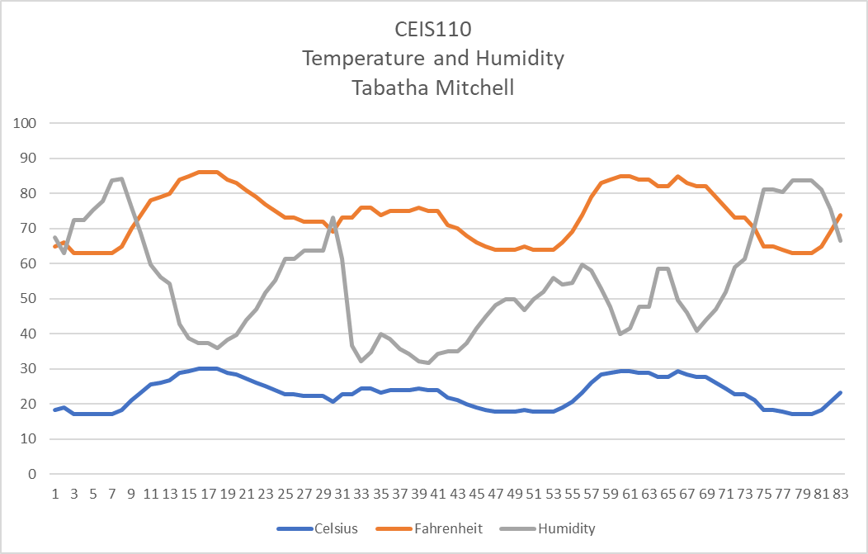
Temperature and Humidity Chart
(Graph)
Excel chart based on temperature and humidity data from database

Slide 17
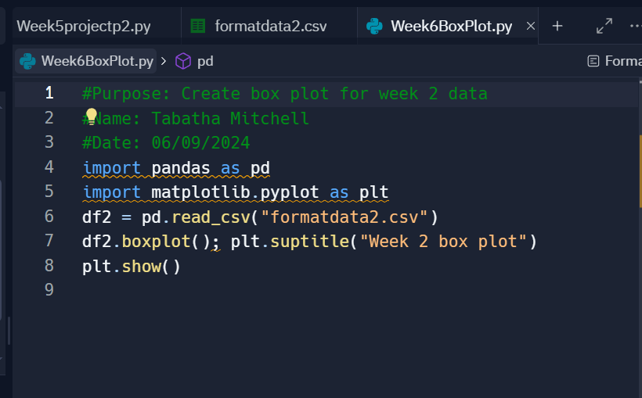
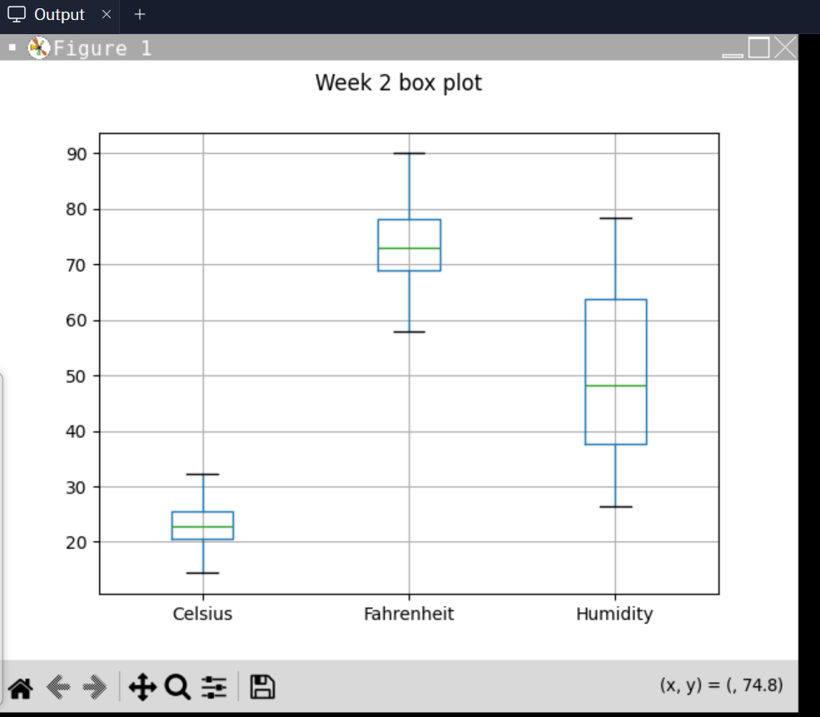
Plot #1
Box plot for week 2 data with code.
Box Plot

Slide 18
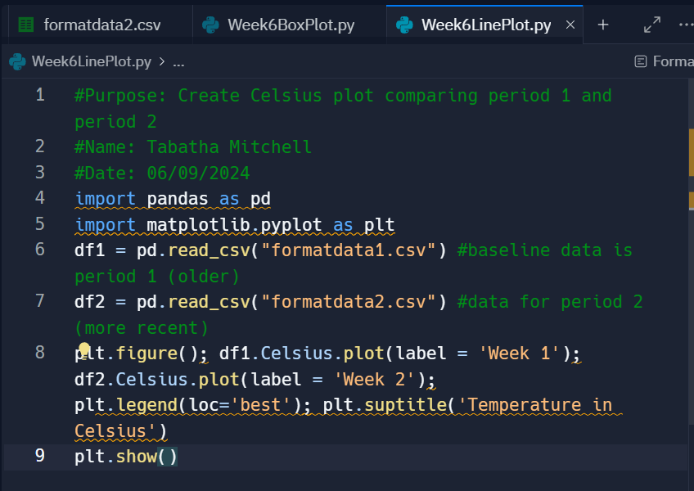
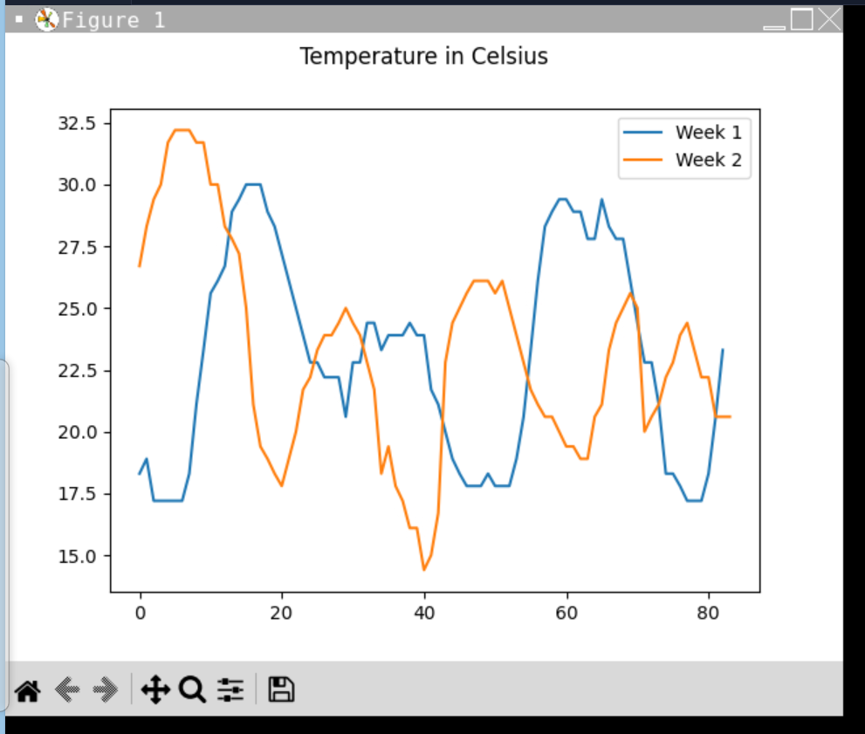
Plot #2
Celsius plot comparing period 1 and period 2 with code.
Line Plot

Slide 19
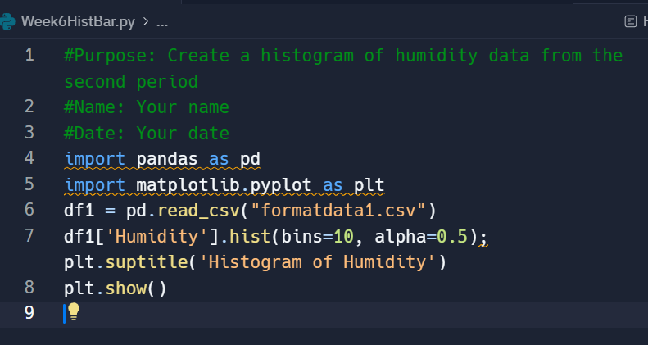
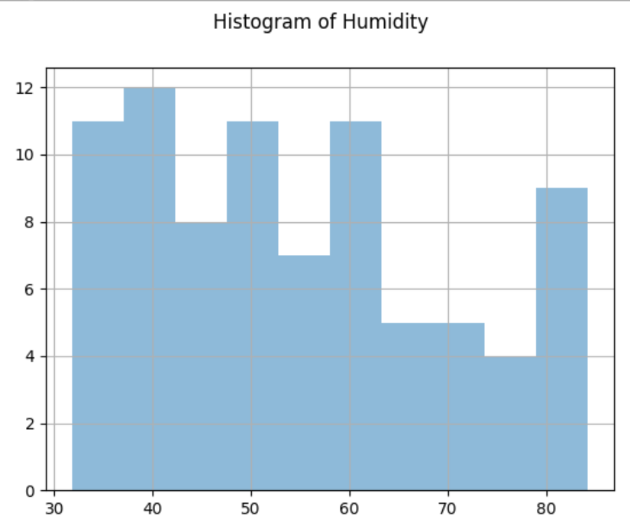
Plot #3
Histogram of humidity data from the second period

Slide 20
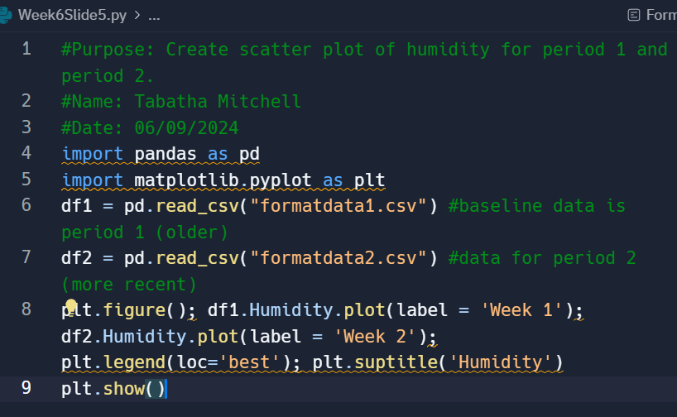
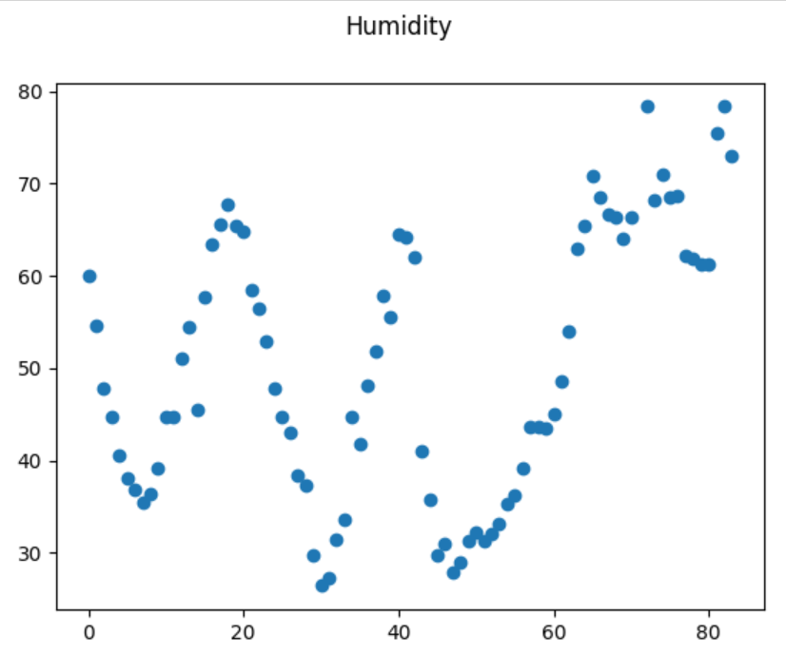
Plot #4
Scatter plot of humidity for period 1 and period 2.

Slide 21
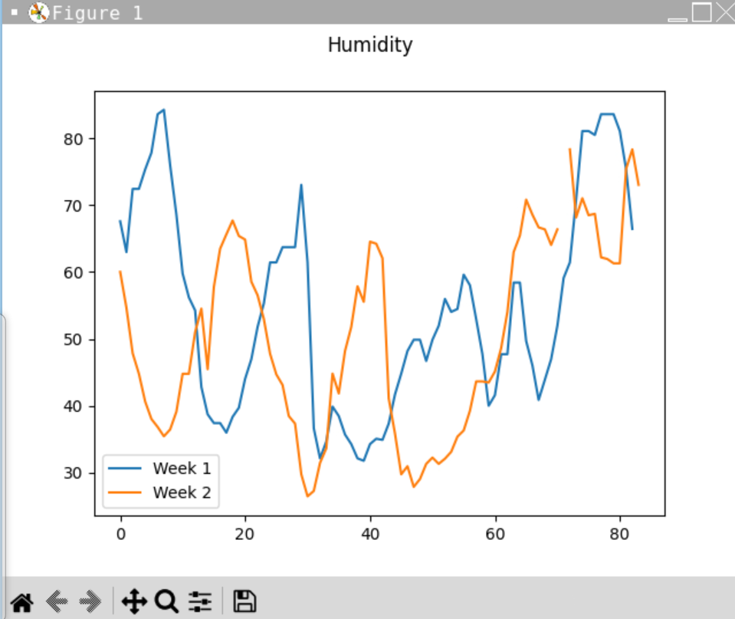

Analysis
Were there differences in temperature and humidity between the two weeks?
It was the same at certain points, but overall there were differences.
Was one week warmer or cooler, or dryer or wetter than the other?
Weeks one and two seemed even in temperature, but week 2 had the hottest and the coldest days.
For a more visual understanding, I have generated two plots. The first one shows the temperature variations between week 1 and week 2, and the second one illustrates the changes in humidity over the same period.

Slide 22
Prediction
Develop a prediction based on the data. What variations in temperature and humidity do you expect over the next few hours or days? How would humidity change if the temperature goes up or down?
Today is 06/09/20, and the temperature is currently in the 60s. I predict that the temperature will drop to the 50s throughout the night. The temperature and humidity fluctuate, but as the temperature falls, the humidity rises. When the temperature rises, the humidity falls.

Slide 23
Challenges
This class was my first introduction to loops and nested loops. It was a challenging experience, and I am eager to continue learning.
Creating a list in Python was both challenging and enjoyable.

Slide 24
Career Skills
An introduction to programming course can equip you with valuable skills that are relevant to various careers.
Programming with Python
Troubleshooting errors in code
Analysis like reviewing charts and graphs to make predictions on the data
Database development
Communication using flowcharts to depict the plan of a project

Slide 25
Conclusion
Introduction to programming provided a strong foundation. It's important to continue building and applying these basics to real-world projects. With dedication and practice, I can develop my skills and explore creating innovative software and applications. I'm excited to embrace the challenges and opportunities ahead in programming.

