Slide 1

CEIS 114
Final Project
Creating a Multiple Traffic Light Controller with a Cross Walk and an Emergency Buzzer with secured IoT Control via Web
By: Tabatha Mitchell

Slide 2
Introduction
IoT devices use sensors, controllers, and actuators as their core parts. The digital device acts as the system's brain. They provide real-time information through feedback loops. In a closed-loop system, the controller constantly receives data from sensors and adjusts conditions as needed.

Slide 3
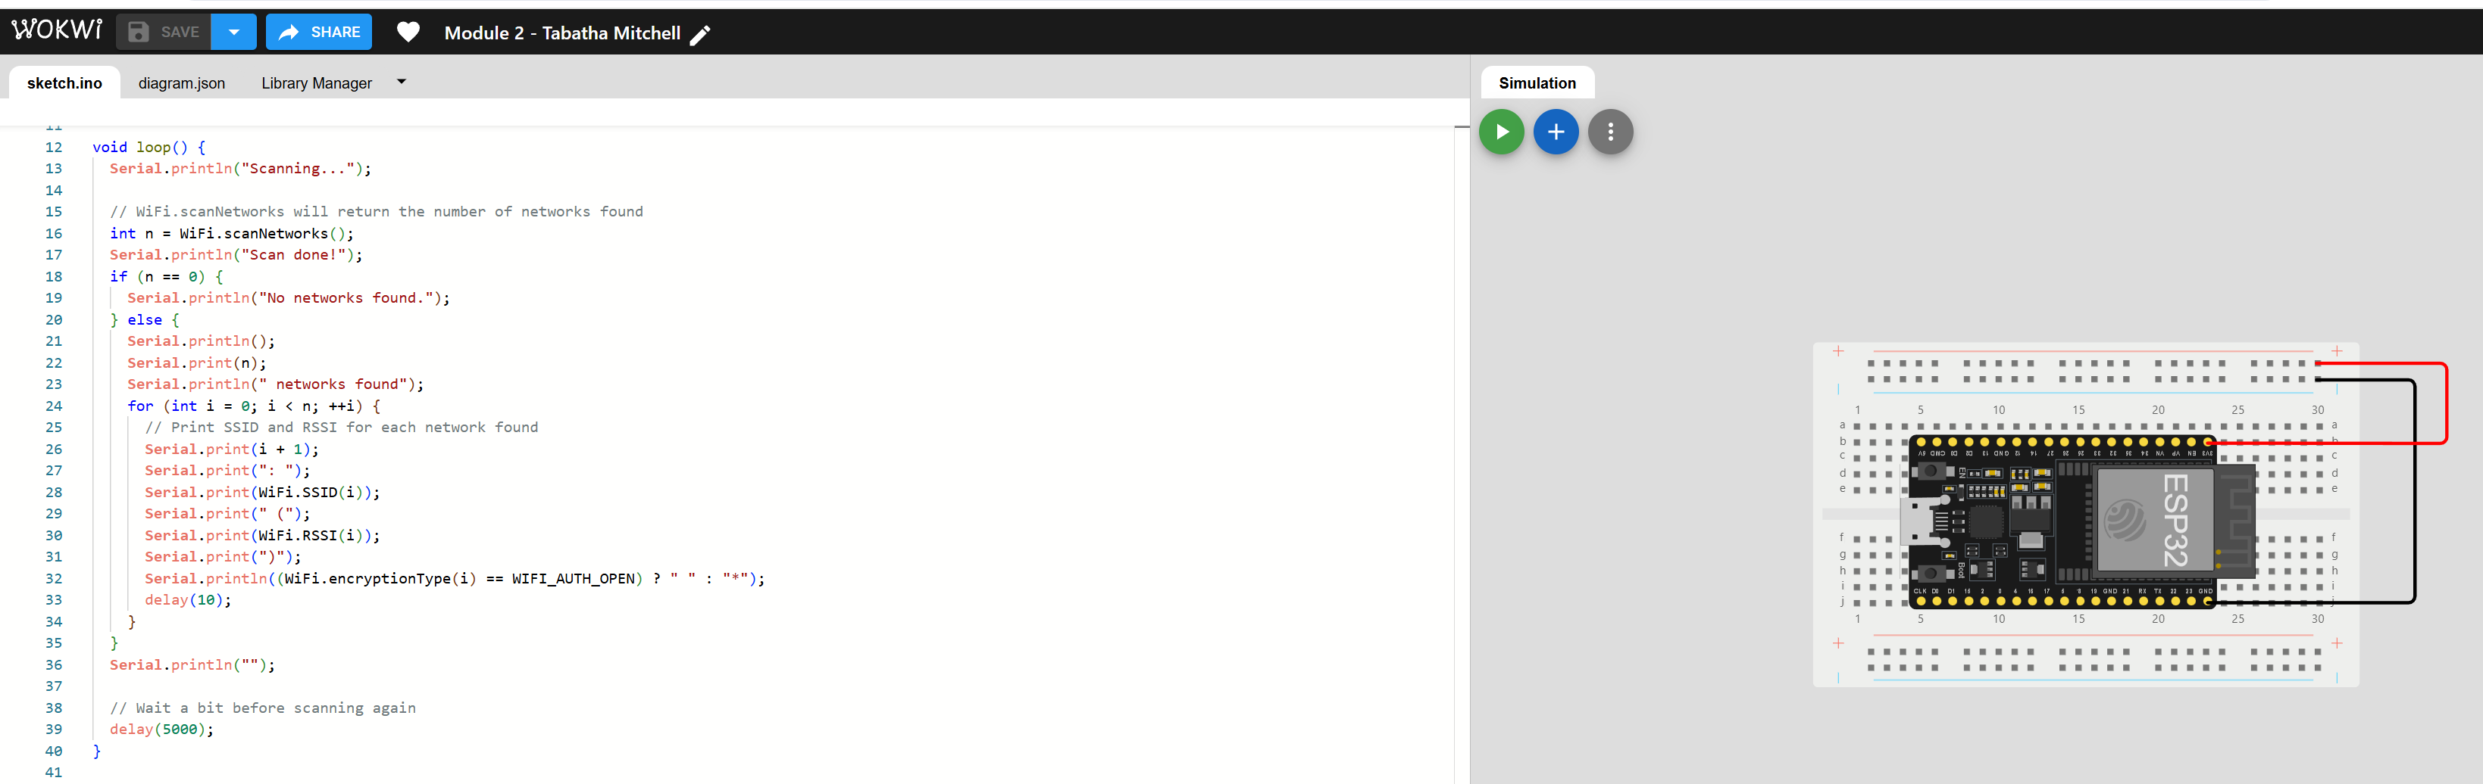
ESP32 (Screenshot)
Microcontroller mounted and powered ON

Slide 4
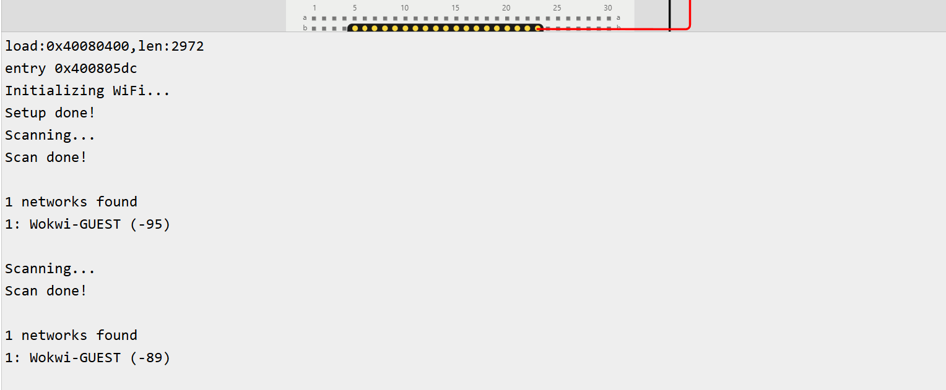
ESP32 WiFi Scan
Screenshot of Serial Monitor showing the available networks

Slide 5
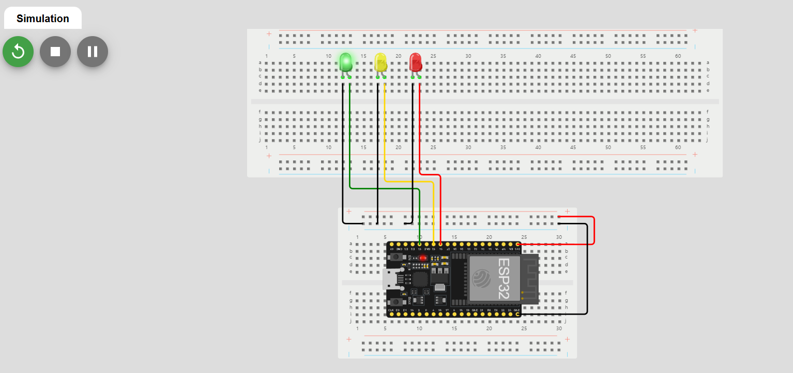
Picture of circuit with working LEDs
ESP 32 Board
Colored LEDs: Red, Yellow and Green
Wires
Breadboard

Slide 6
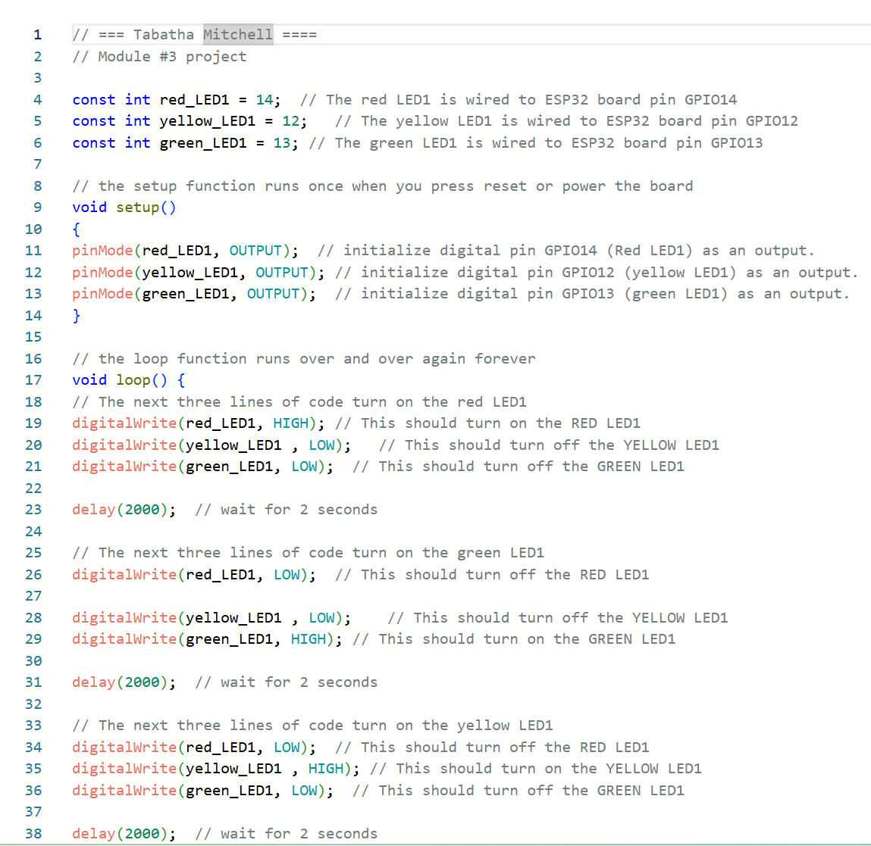
Screenshot of code in the Code Editor
Screenshot of code in the Wokwi Code Editor showing your name in the comment

Slide 7
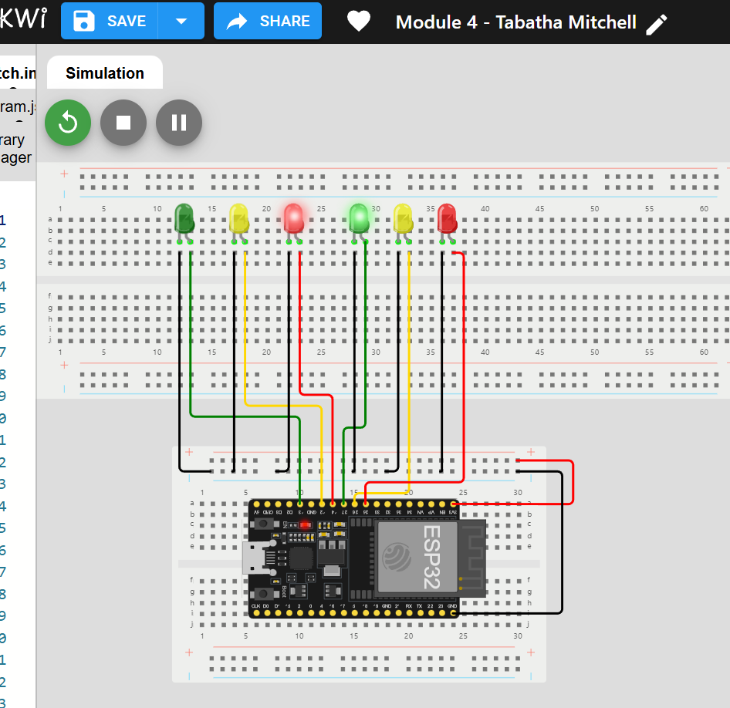
Picture of circuit with working LEDs
ESP 32 Board
Colored LEDs: Red, Yellow and Green (two sets)
Wires
Breadboard

Slide 8
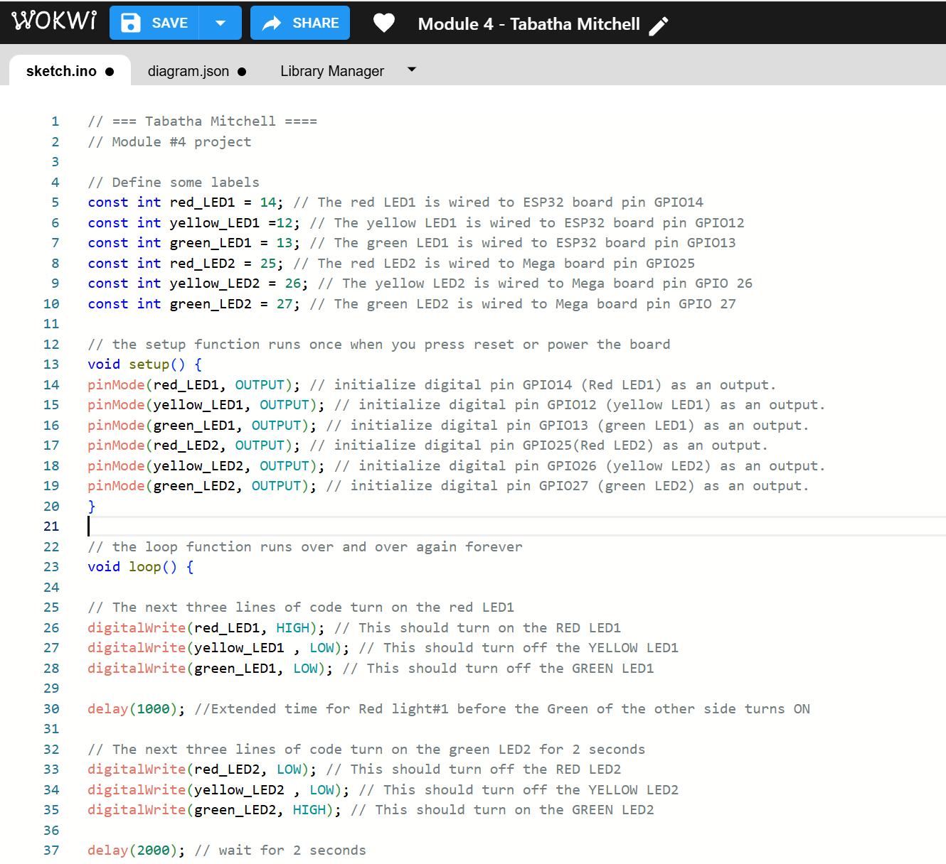
Screenshot of code in Wokwi
Screenshot of code Wokwi Code Editor showing your name in the comment

Slide 9
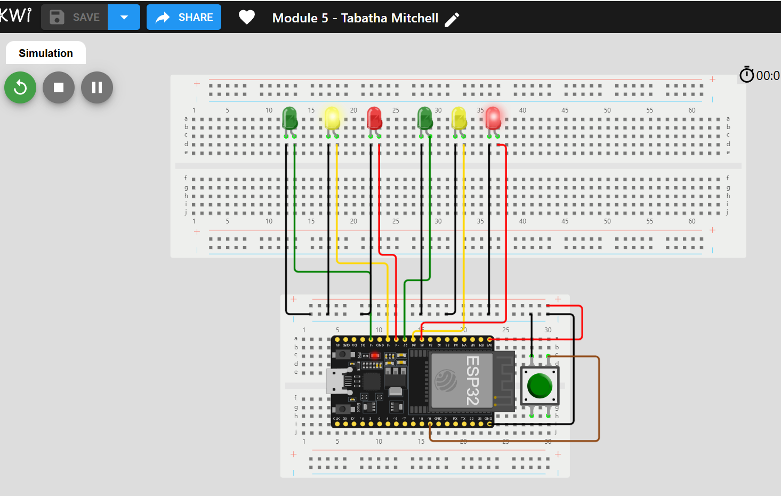
Screenshot of circuit with working LEDs
ESP 32 Board
Colored LEDs: Red, Yellow and Green (two sets)
220 Ohm Resistors (optional)
Push Button
Wires
Breadboard

Slide 10
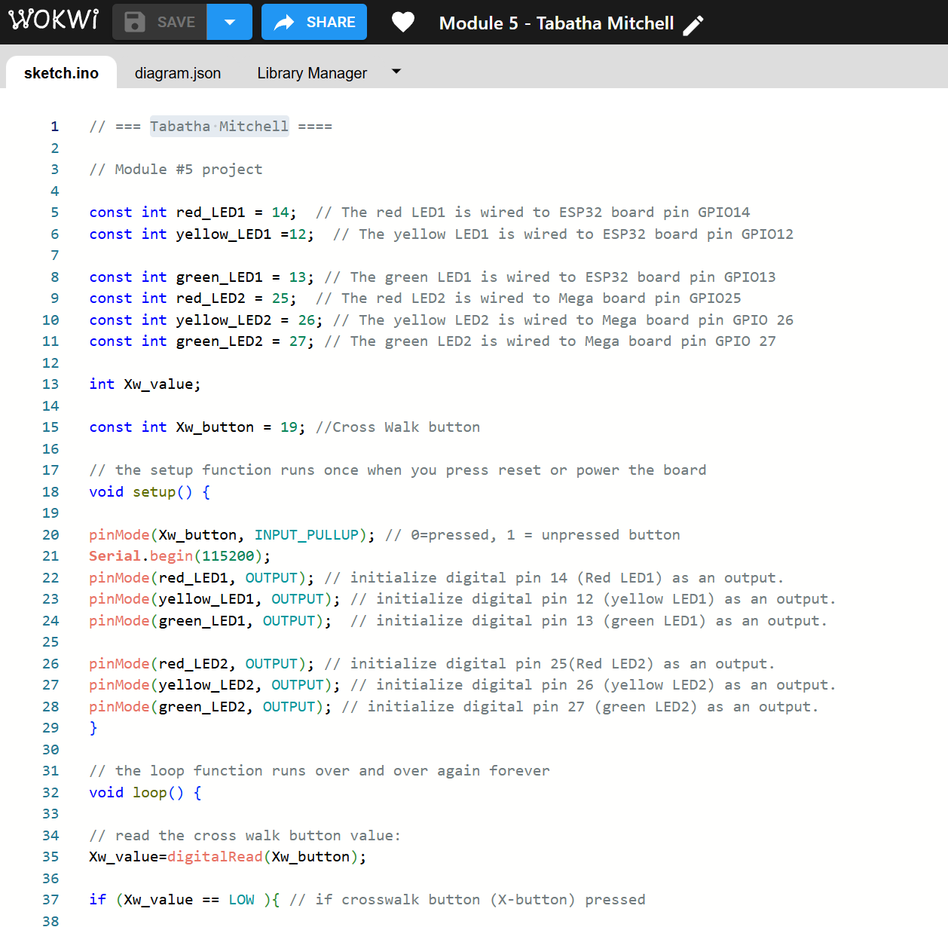
Screenshot of code in Wokwi
Screenshot of code in Wokwi Code Editor showing your name in the comment

Slide 11
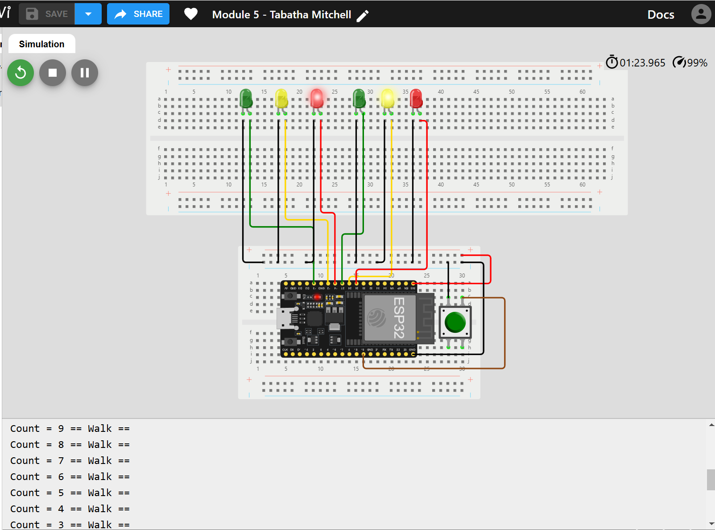
Screenshot of Serial Monitor in Wokwi
Screenshot of output in Serial Monitor

Slide 12
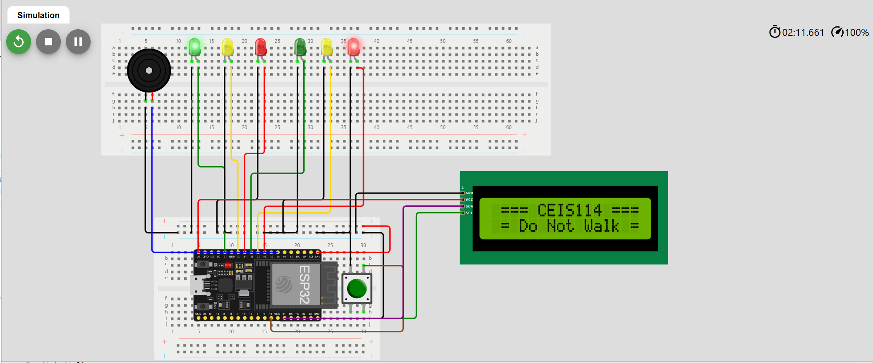
Picture of circuit with working LEDs and LCD display
ESP 32 Board
Colored LEDs: Red, Yellow and Green (two sets)
220 Ohm Resistors (optional)
Push Button
LCD Unit with Message Display
Wires
Breadboard

Slide 13
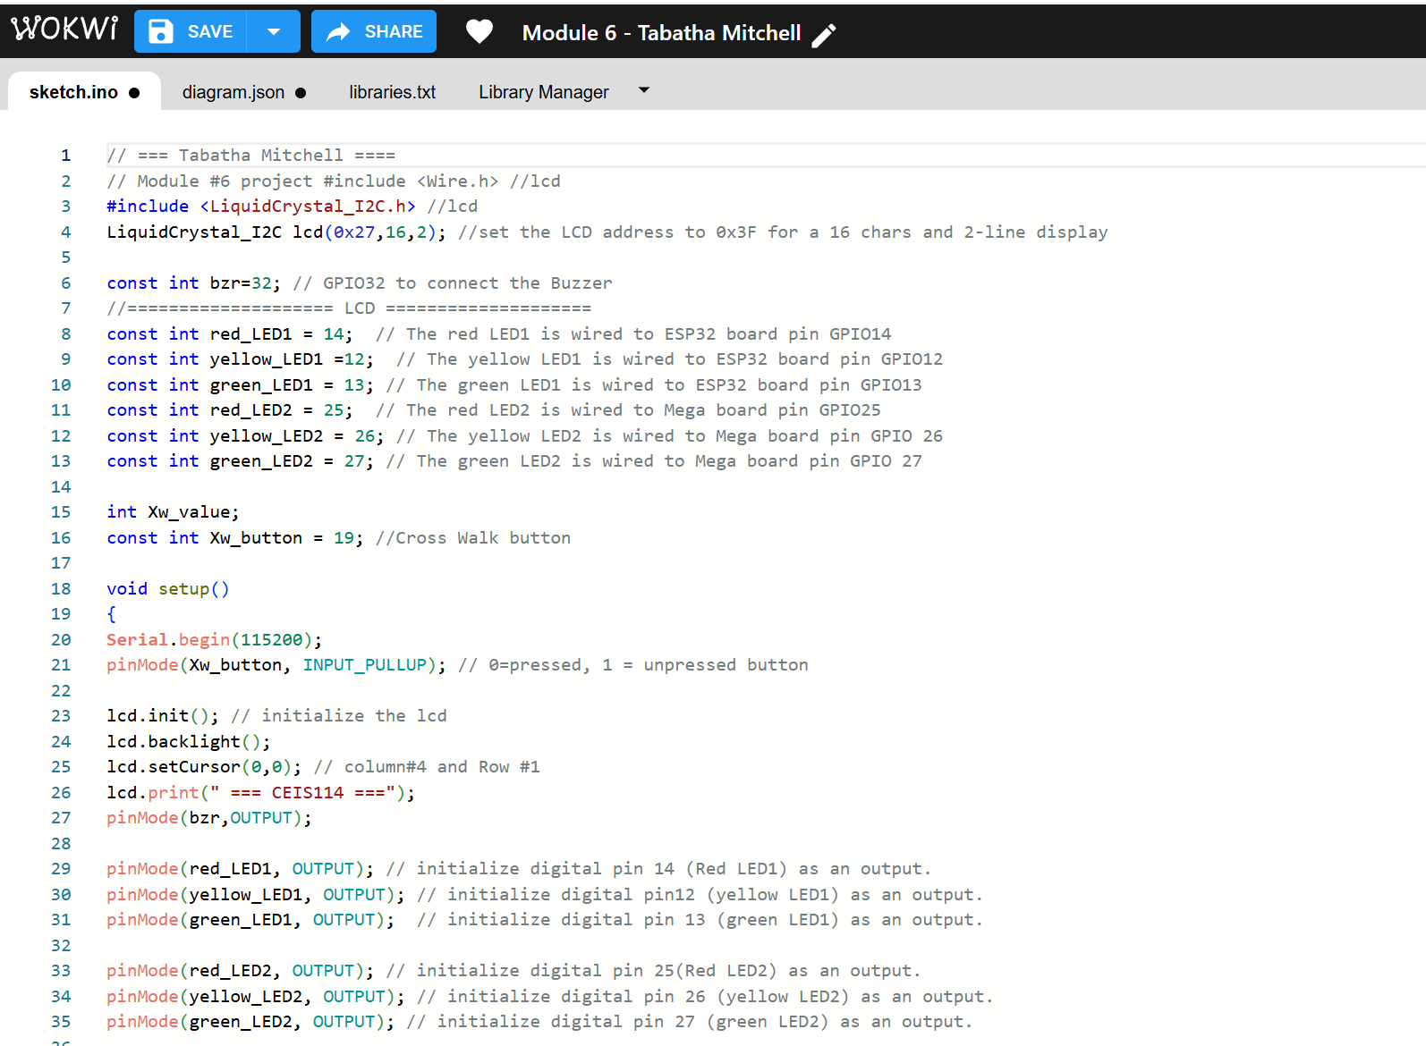
Screenshot of code in Code Editor
Screenshot of code in Code Editor showing your name in the comment

Slide 14
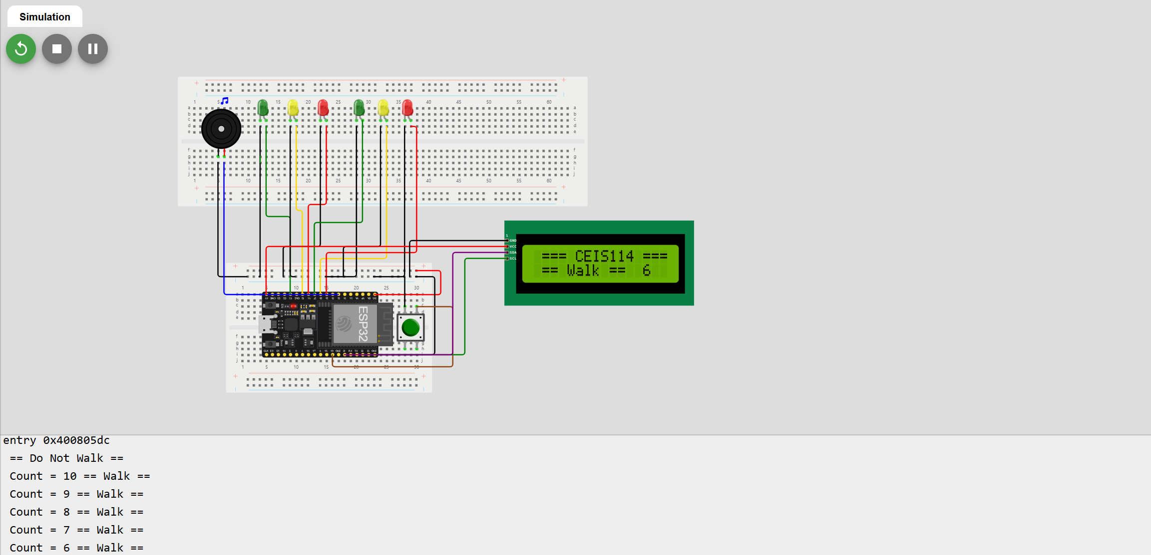
Screenshot of Serial Monitor
Screenshot of output in Serial Monitor

Slide 15
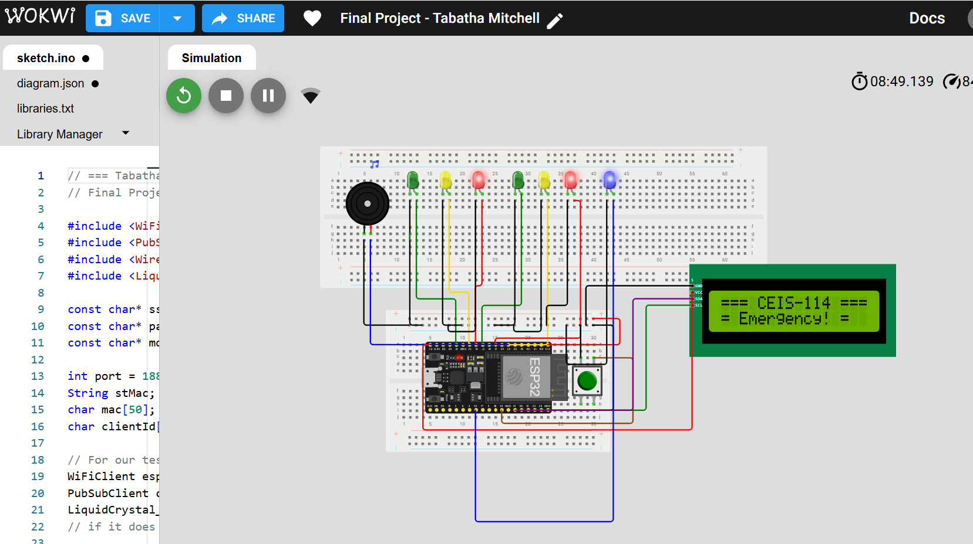
Screenshot of circuit with working LEDs and LCD display (Building/Operation)
ESP 32 Board
Colored LEDs: Red, Yellow and Green (two sets)
One Blue LED – Emergency Light
Push Button
LCD Unit
Buzzer
Wires
Breadboard

Slide 16
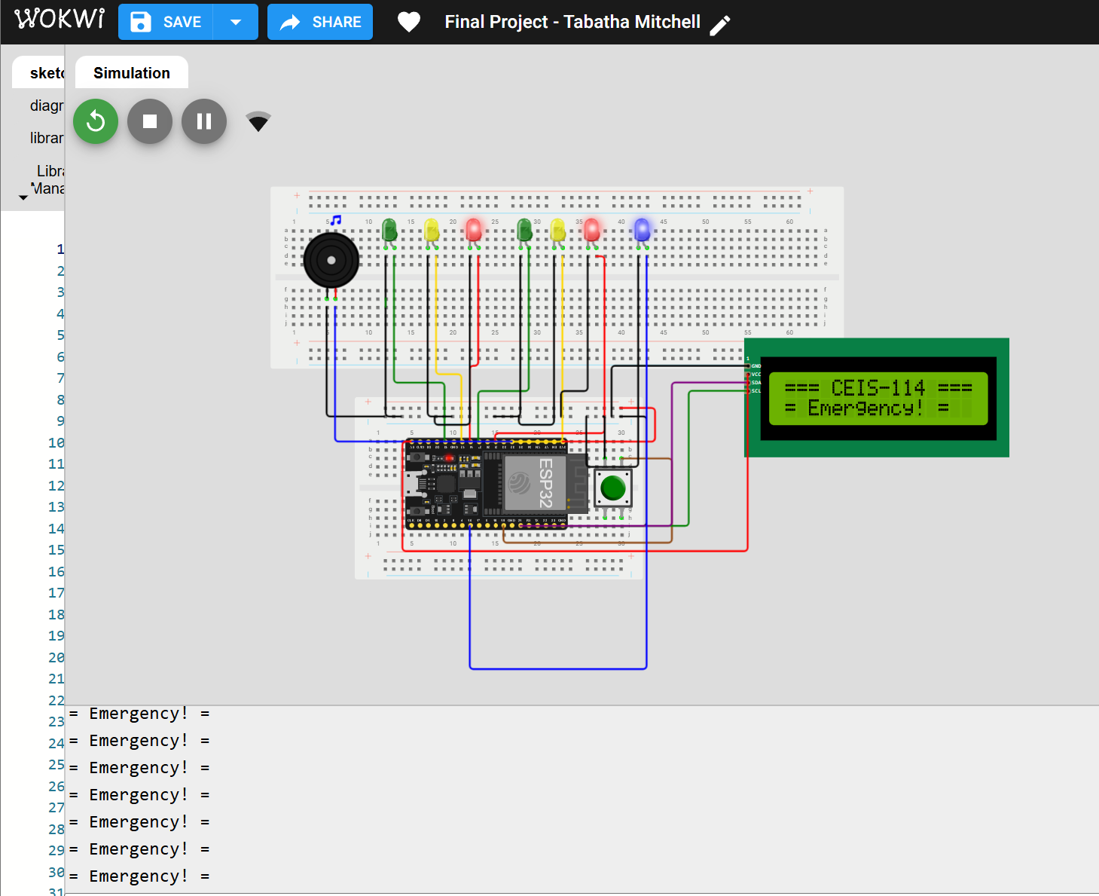
Screenshot of resources (Identification)
Resources needed to build a smart traffic controller.

Slide 17
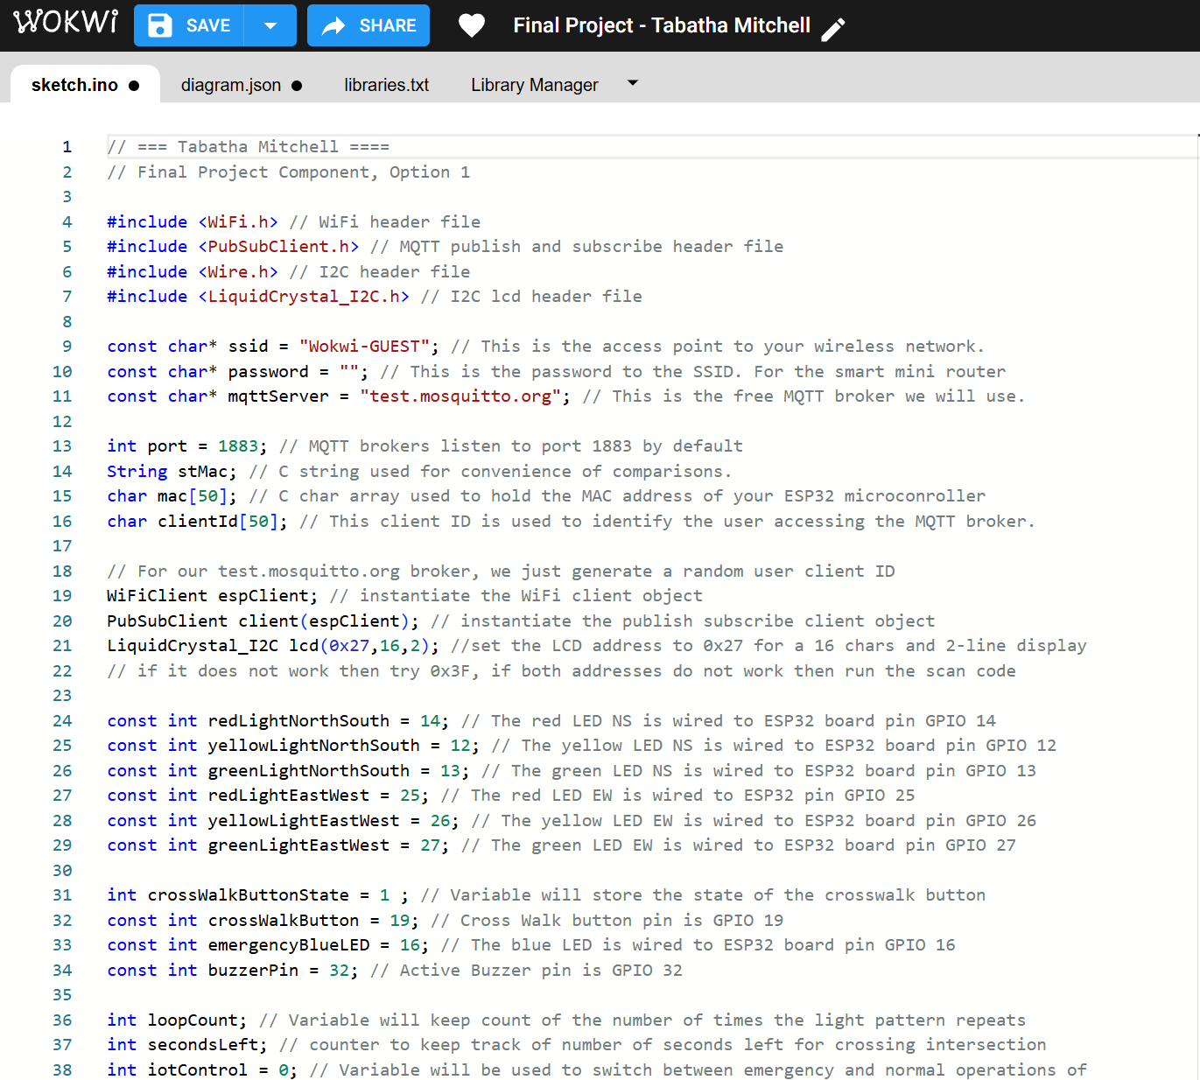
Screenshot of code in Code Editor (Testing)
Screenshot of code in Code Editor showing your name in the comment

Slide 18
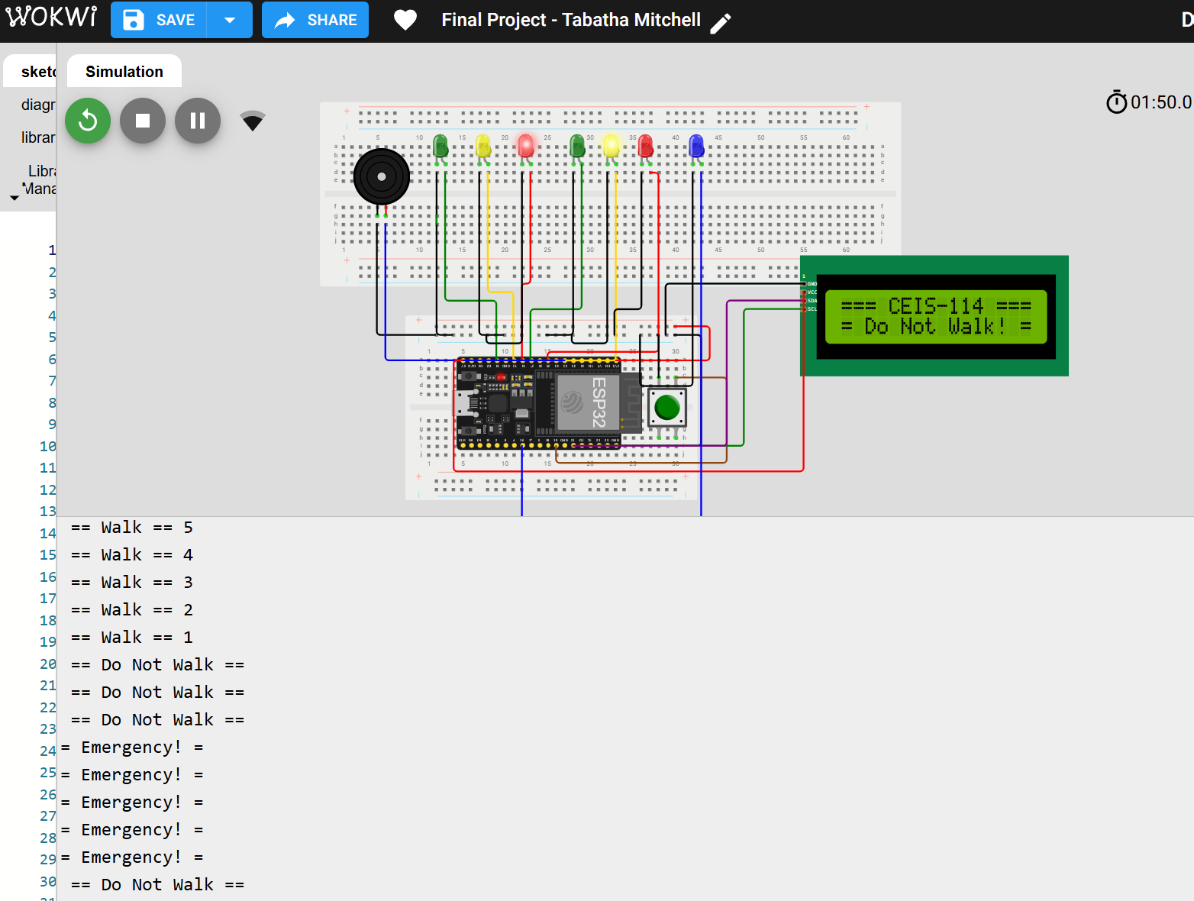
Screenshot of Serial Monitor (Testing)
Screenshot of output in Serial Monitor

Slide 19
Career Skills
Network Administrator
IT Support Specialist
IoT Solutions Engineer
Systems Analyst
Network Technician
Digital Device Developer
Technical Support Engineer
Cybersecurity Analyst
Hardware Engineer
Software Installer

Slide 20
Conclusion
In conclusion, IoT devices operate efficiently through a closed-loop system, where sensors constantly provide data to the controller, allowing for real-time adjustments and responses. This highlights the importance of feedback loops in maintaining optimal conditions and underscores the integral role of the digital device as the system's brain. Overall, this mechanism enables IoT devices to deliver valuable, real-time information and adapt to changing circumstances seamlessly.

