Slide 1
Programming with Objects
By: Tabatha Mitchell

Slide 2
Introduction
Comprehensive understanding of object-oriented programming principles(OOP)
  Python control structures
  Sequence
  Selection
  Repetition
  Lists
  Functions
Topics including classes, objects, inheritance, polymorphism, abstraction, and encapsulation
Design, implementation, and management of classes and objects

Slide 3
Setting Up Environment
Before starting this programming and data project, I downloaded and installed all the necessary software.
The required software includes Excel, Visual studio code, Spider (anaconda), gits
Creating a price list with the welcome message.

Slide 4

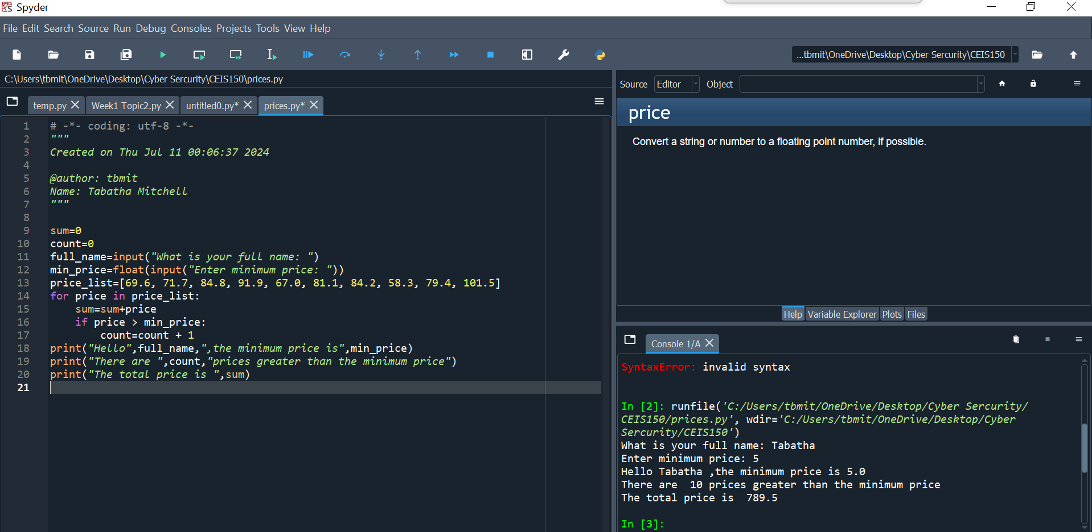
Program
Software Environment Setup
Screen shot of Python program running successfully.

Slide 5
Creating the Classes
Utilization of abstraction, inheritance, and polymorphism for creating maintainable programs.
I created a Class Diagram using Visual Studio.
Working on the stock_class.py file, I created a Class Stock and Class Daily Data Code using Spyder.
The Unit Test was successful.

Slide 6
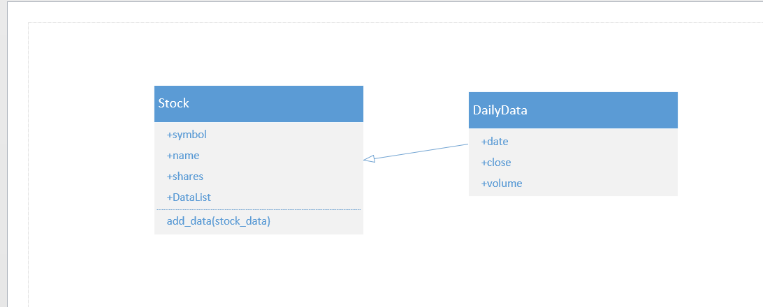
Class Diagram
Paste your Visio Class Diagram

Slide 7
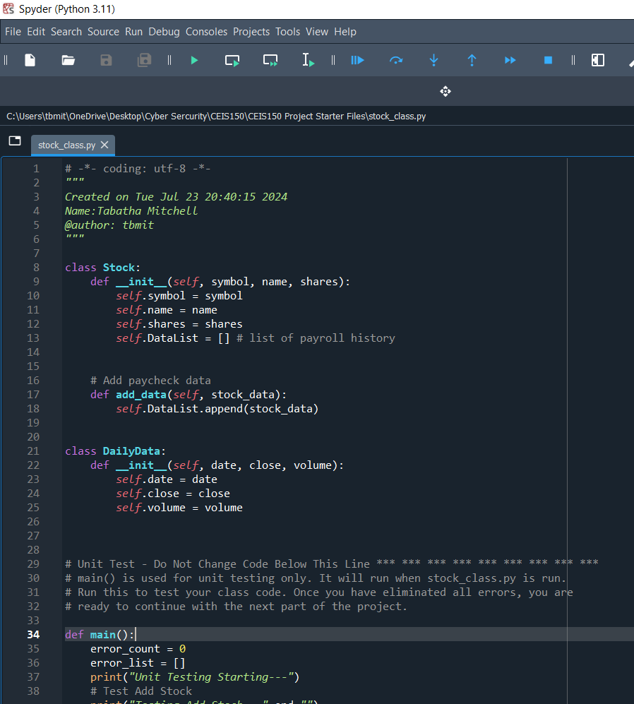
Class Code
Screen Shot of your stock_class.py file.

Slide 8
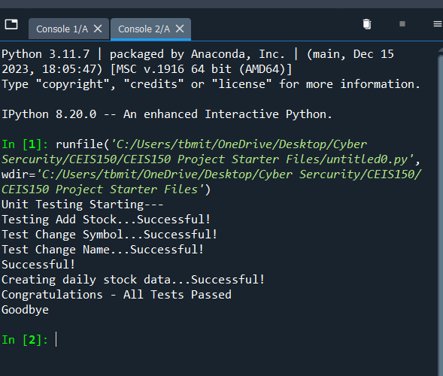
Unit Test
Screen Shot of your successful unit test.

Slide 9
Creating a console-based interface
Working on stock_menu.py in Spyder, I wrote code to add, delete, and list stock data. I was also successful in retrieving daily stock data.

Slide 10
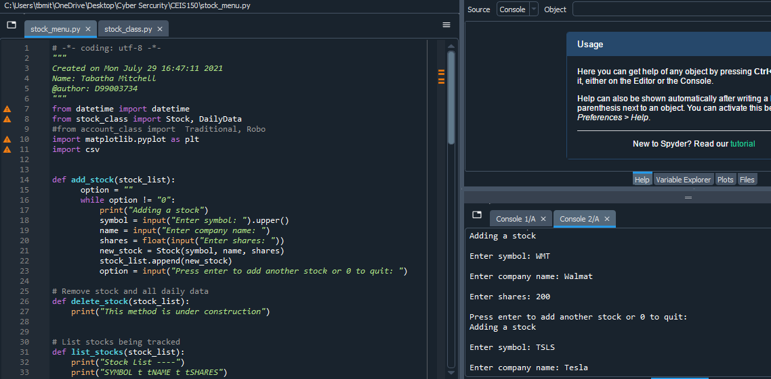
Adding a Stock
Screenshot of your working Stock program.

Slide 11
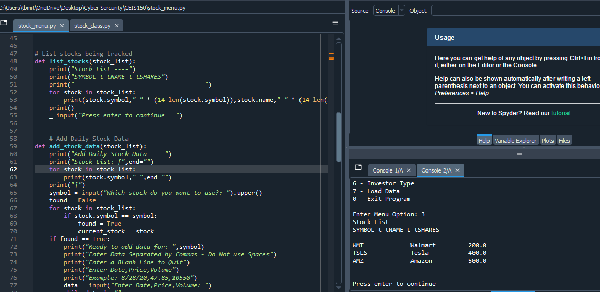
Listing 3 Stocks
Screenshot of your working Stock program.

Slide 12
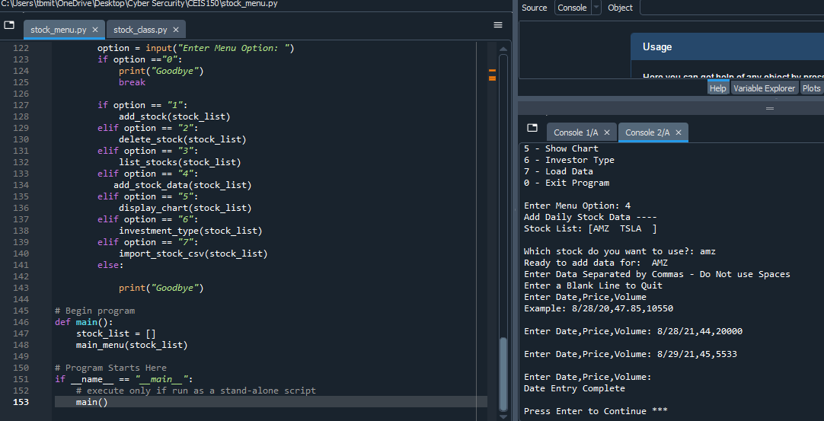
Daily Data
Screenshot of your working Stock program.

Slide 13
Inheritance
Creating classes inherited from a base class.
Creating account_class.py in the same directory as stock_menu.py and stock_class.py.
  Implement inheritance in the stock program
  Create three classes
  Run the unit test, and all tests passed
I added code to account_class.py and added more code to stock_menu.py, adding a working investor type button to the menu.

Slide 14
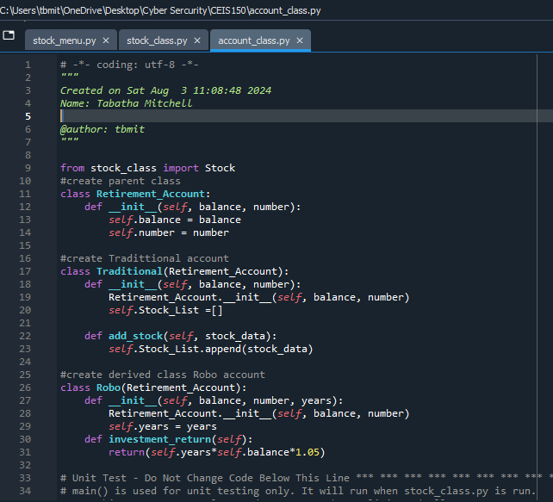
Inherited classes
Screenshot of classes

Slide 15
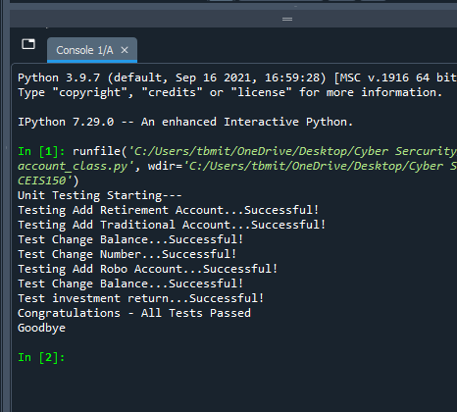
Unit Tests
Screenshot of your unit tests successfully completed

Slide 16
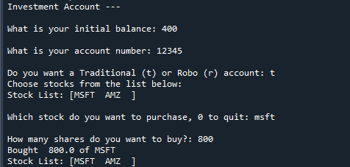
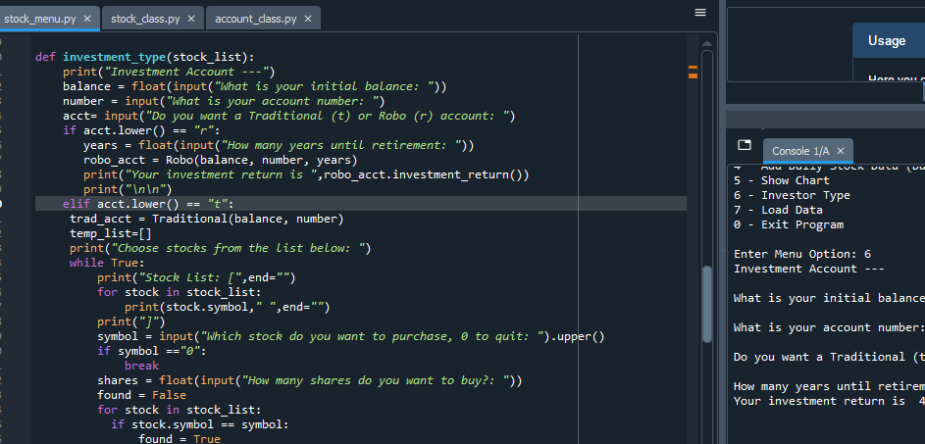
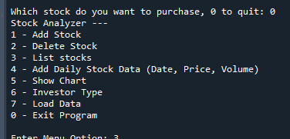
Stock menu program
Paste a screen shot of your
classes in the main program

Slide 17
Creating a Chart Using the matplotlib
To create a stock chart, we will use the matplotlib library. This library makes it easy to create many visualizations, from simple line charts to more complex and interactive graphics.
In the stock_menu.py file, I used Spyder to create a code that enables the display of a stock chart in Python.

Slide 18
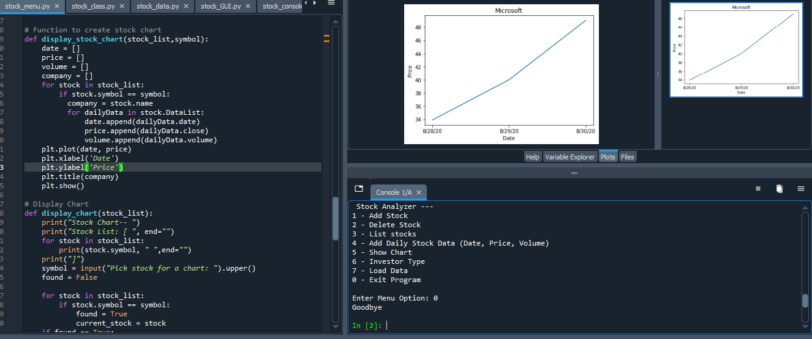
Chart
Screenshot of your stock chart.

Slide 19
Working with Files
By processing the historical stock data, profit/loss reports can be generated. Data storage will allow users to save and retrieve stock data. The system will use the Python libraries to create charts.
Using Yahoo Finance provides historical data as a downloadable csv file.

Slide 20
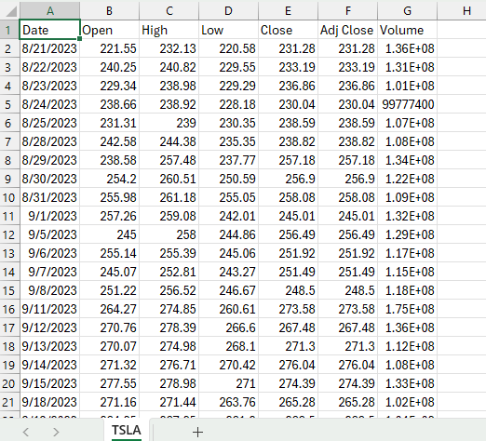
File
Screenshot of the file downloaded from Yahoo finance

Slide 21
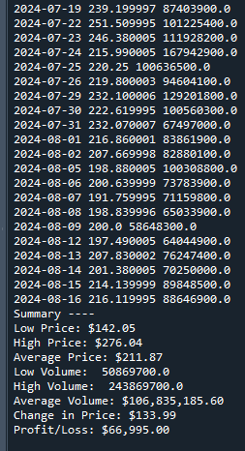
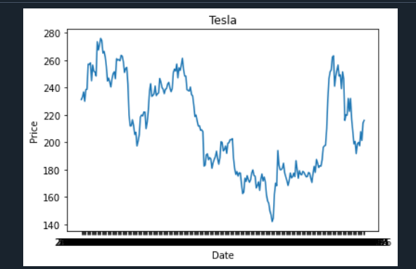
Importing data
Screenshot of the historical data import

Slide 22
Creating a Graphical User Interface
Creating software with many user interfaces including text-based, graphical user interfaces (GUIs), and web.
In the stock_GUI.py file I inputted the code for:
  display_stock_data()
  add_stock()
  delete_stock()
  display_chart()
Once I finish, I open the Git Bash app, input the stocks for which I want to receive data, and use the CSV files that I have already downloaded.

Slide 23
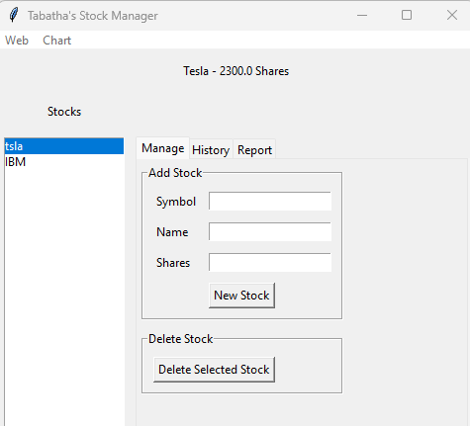
Stocks in GUI
Screenshot of your GUI working

Slide 24
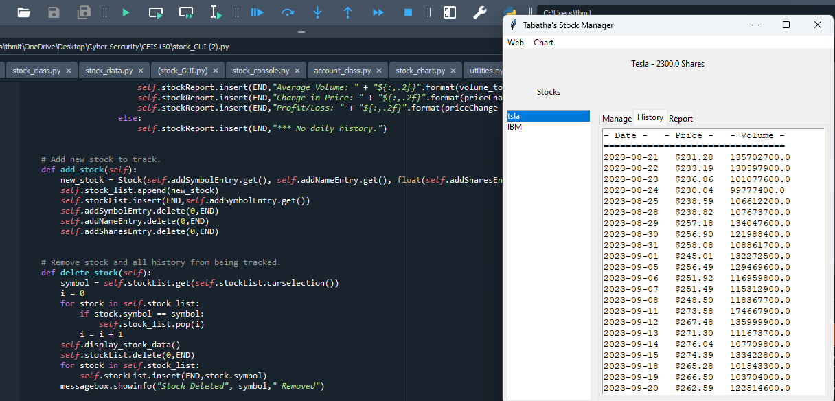
History Tab
Screenshot of your History tab with import working.

Slide 25
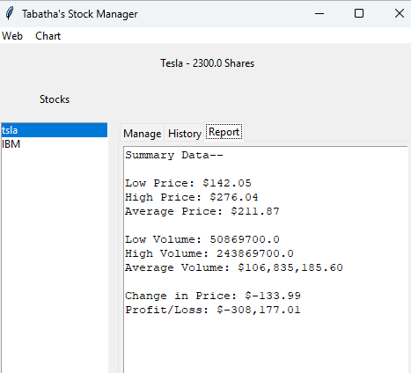
Report Complete
Screenshot of your Report tab

Slide 26
Challenges
Writing code was my number one challenge.

Slide 27
Career Skills
Object-oriented programming (OOP) principles and practices
Designing and implementing efficient, reusable, and maintainable code using objects and classes
Understanding and implementing inheritance, polymorphism, and encapsulation
Working with interfaces and abstract classes
Utilizing design patterns to solve common software design problems
Collaborating in teams to develop object-oriented software solutions
Analyzing and debugging object-oriented code
Creating software that is scalable and adaptable to changing requirements

Slide 28
Conclusion
Programming with objects uses object-oriented programming, which allows for creating flexible, reusable, and well-organized code. It enables encapsulation, inheritance, and polymorphism, which help make code reusable and improve its organization. This approach enhances the overall design and functionality of the software.

