Slide 1
Fundamentals of Infrastructure Security
Tabatha Mitchell
SEC290

Slide 2
Introduction
Cybersecurity is important in our connected world. In SEC290, I learned the basics of keeping information safe and how bad guys try to steal it. I found out how experts catch these bad guys and stop them from attacking. I also looked at some real-life examples of security problems. This course helped me understand how to stay safe online. In this presentation, I will share some simple ideas from the course and how they help us keep our information safe.

Slide 3
Basic attack analysis
This report looks at how to find tricks on the internet using a tool called Wireshark. We check small pieces of data to see if they show any weird or dangerous activity. We also figure out what type of computer is sending a signal based on how it pings back. Knowing these details helps us spot problems early and keep our networks safe.

Slide 4
Basic attack analysis
Look at captures no. 20 and 22. (You can use the “Go” link at the top of the Wireshark screen to quickly go to a specific capture) Both packets are ICMP traffic but there are subtle differences between them. Compare the time-to-live and data field sizes in the two packets. What differences do you see?
  20. ttl(time-to-live)= 64
  22. ttl(time-to-live)= 128
Do a little Internet research to discover which operating systems use the specific values in their ping commands. What operating system generated the echo request in capture 20?
  20. ttl(time-to-live)= 64 /operating system generated the echo request in capture 20 is Linux/Unix.
  22. ttl(time-to-live)= 128 /operating system generated the echo request in capture 22 is Windows.
Review packet no. 37 and beyond, what do you think is taking place here? __________________
  Protocol: TCP and there is a sequence, attacks, and Flags.
Look at capture 22846. What is suspicious about the flag settings in this packet?
  There is a combination from [RST,ACK] to [FIN]
  capture 22846 is [FIN]
  capture 14519 is [FIN, PSH, URG]
What is the IP address of the host being targeted?
  192.168.25.1
  192.168.25.50

Slide 5
SSL/TLS file
Activity
Creating and testing an SSL/TLS file
Creating and Testing an SSL/TLS file cont’d

Slide 6
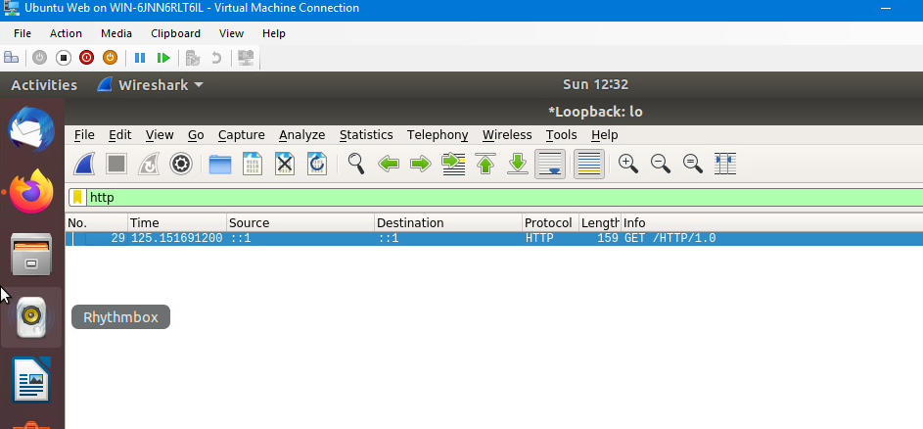
Creating and testing an SSL/TLS file
It should show the GET request in the Info column.

Slide 7
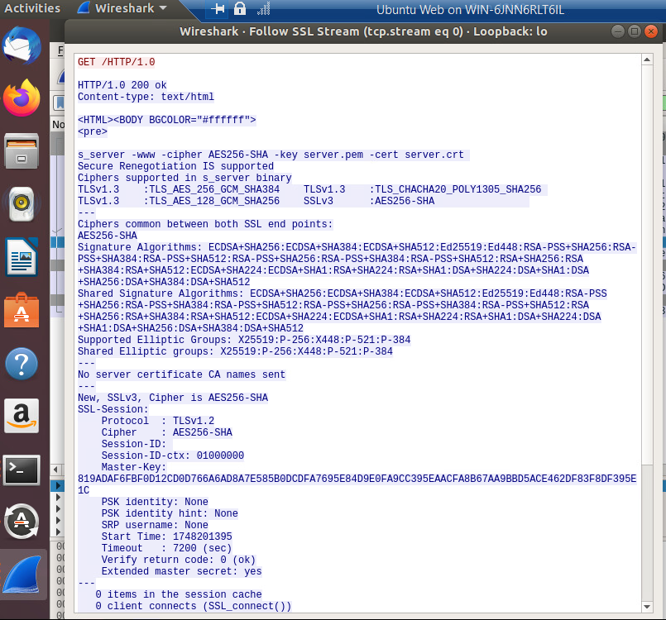
Creating and testing an SSL/TLS file cont’d
It should show the decrypted SSL stream.

Slide 8
Snort rules
Activity
Testing Snort rules
Creating Snort rules

Slide 9
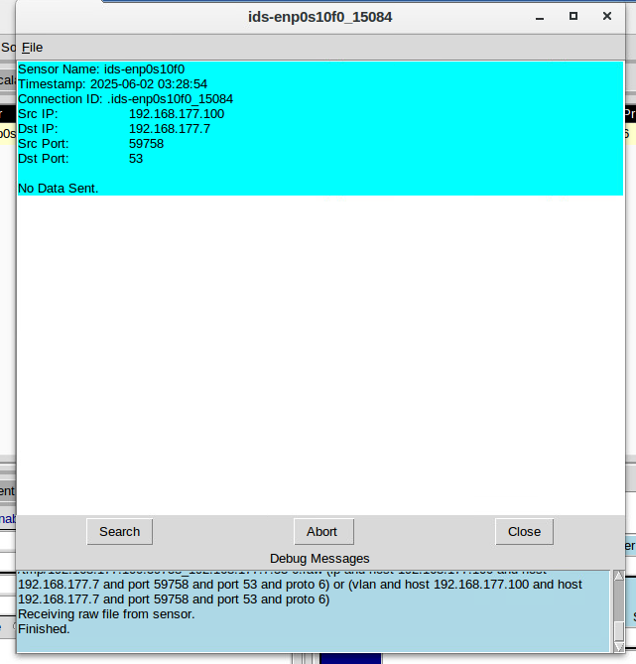
Testing Snort rules
It should show the transcript of the XMAS scan alert.

Slide 10
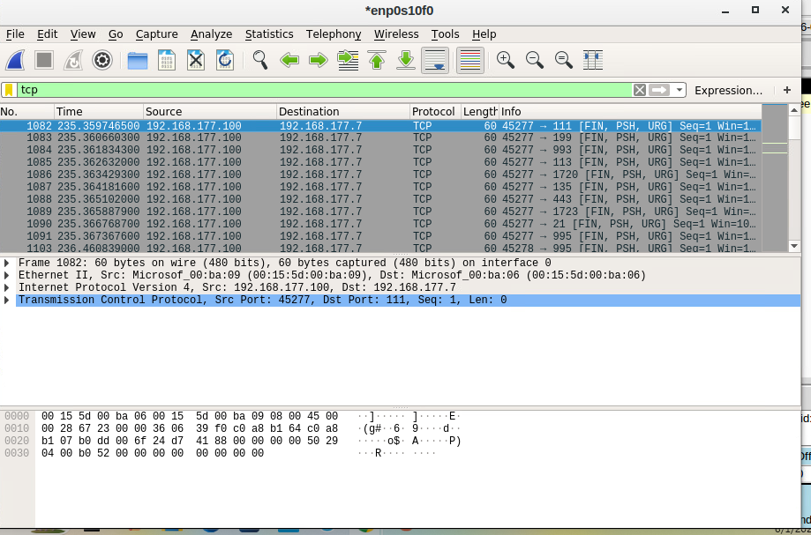
Testing Snort rules cont’d
It should show the TCP packets generated by the XMAS scan.

Slide 11
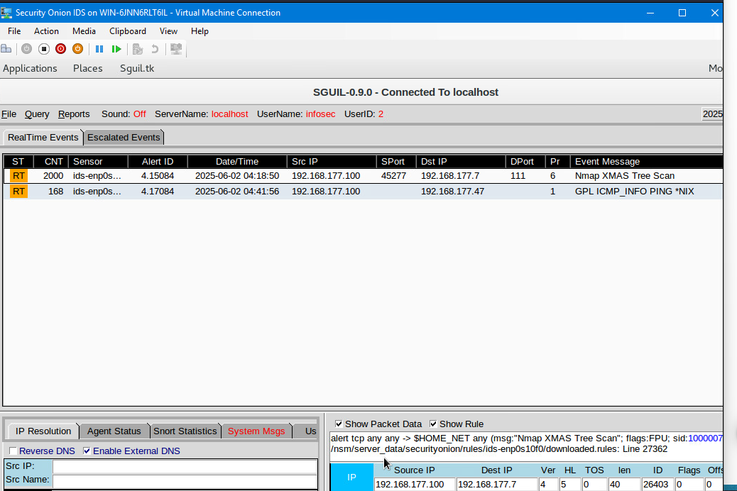
Creating Snort rules
It should show the ping activity alert.

Slide 12
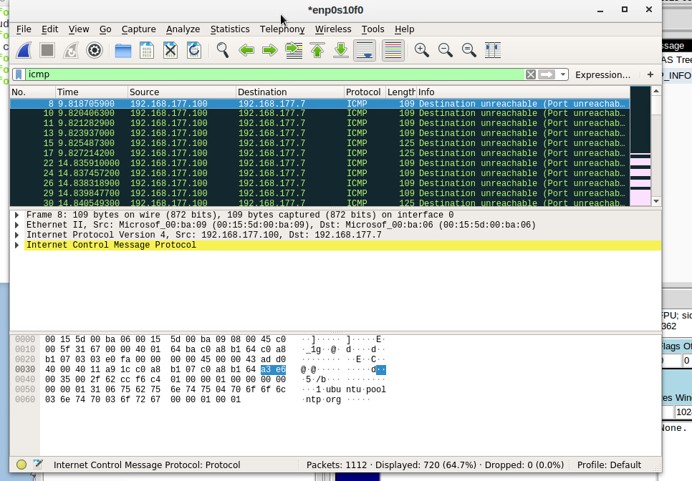
Creating Snort rules cont’d
It should show the ICMP packets generated by the ping activity.

Slide 13
Processes
Activity
Linux Processes
Process Hacker
Process Monitor

Slide 14
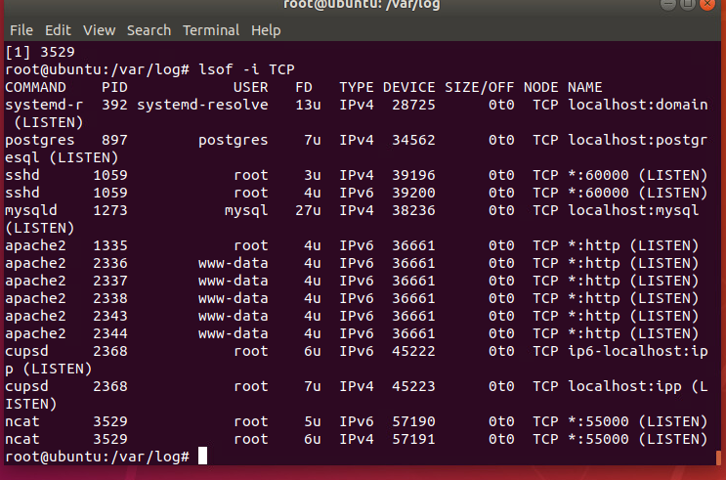
Linux Processes
It should show port 55000 open for both IPv4 and IPv6.

Slide 15
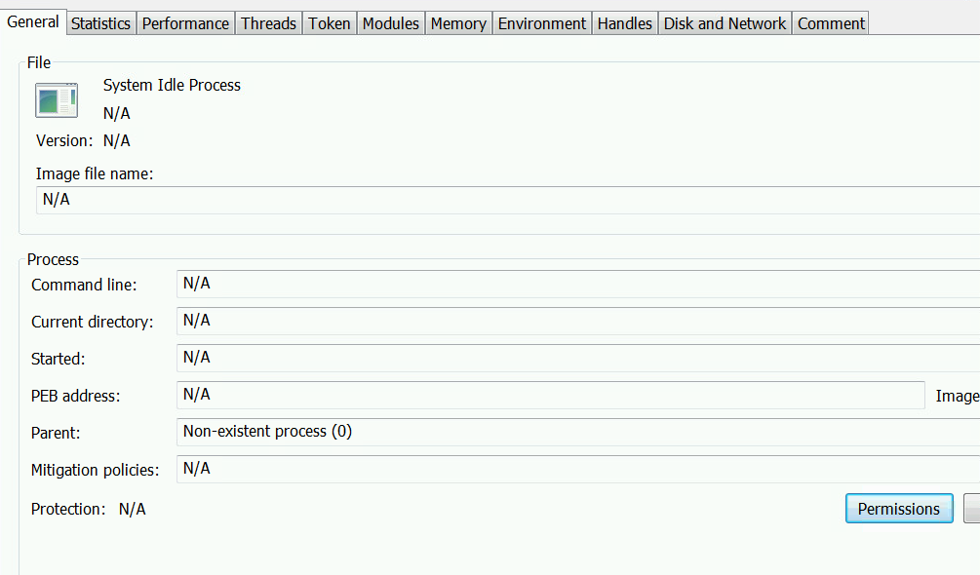
Process Hacker
It should show properties of a chosen process.

Slide 16
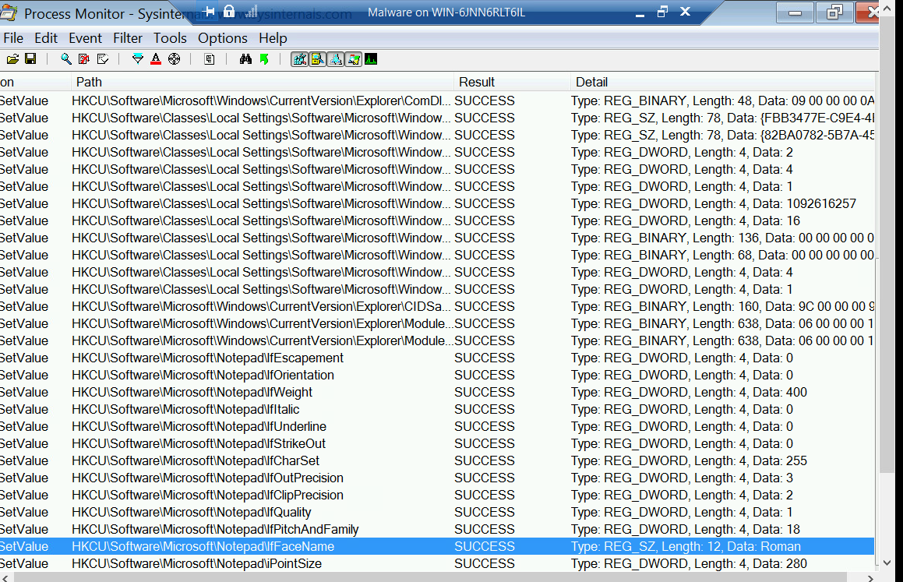
Process Monitor
It should show ifFaceName in the Path column and Data: Roman in the Detail column.

Slide 17
Time-based
Activity
Time-based access - 1
Time-based access - 2
Time-based access - 3

Slide 18
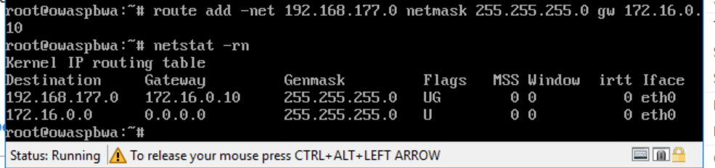
Time-based Access
It should show the output of the DMZ Route Table.

Slide 19
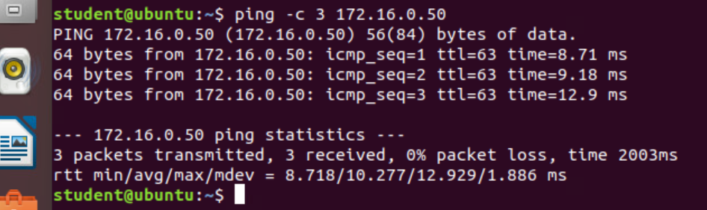
Time-based Access
It should show a successful ping from the Ubuntu Web VM and the DMZ VM.

Slide 20
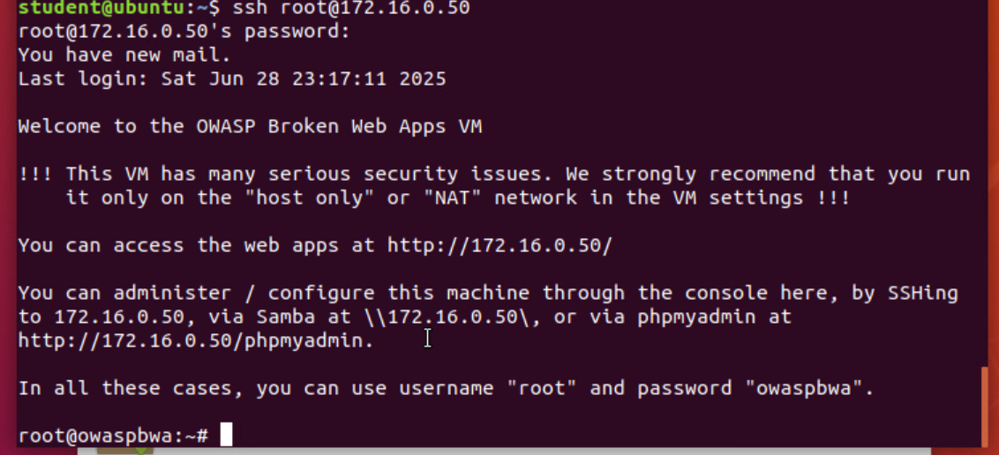
Time-based Access
It should show two time-based access rules in the FORWARD chain

Slide 21
References
Log in | Infosec Learning. (2025). Infoseclearning.com. https://lab.infoseclearning.com/console/5808139/743
Log in | Infosec Learning. (n.d.). Lab.infoseclearning.com. https://lab.infoseclearning.com/course/GFHTMCLELH/lab/ZQTYOOMTNN?check_logged_in=1
Log in | Infosec Learning. (2025). Infoseclearning.com. https://lab.infoseclearning.com/console/5894873/743‌
Log in | Infosec Learning. (n.d.). Lab.infoseclearning.com. https://lab.infoseclearning.com/course/GFHTMCLELH/lab/GIJWCQQCLN?check_logged_in=1

