Slide 1
Smart Home Automation System
CEIS101 Final Course Project
November 2023
Tabatha Mitchell
Prof. Chao-ying Wang

Slide 2
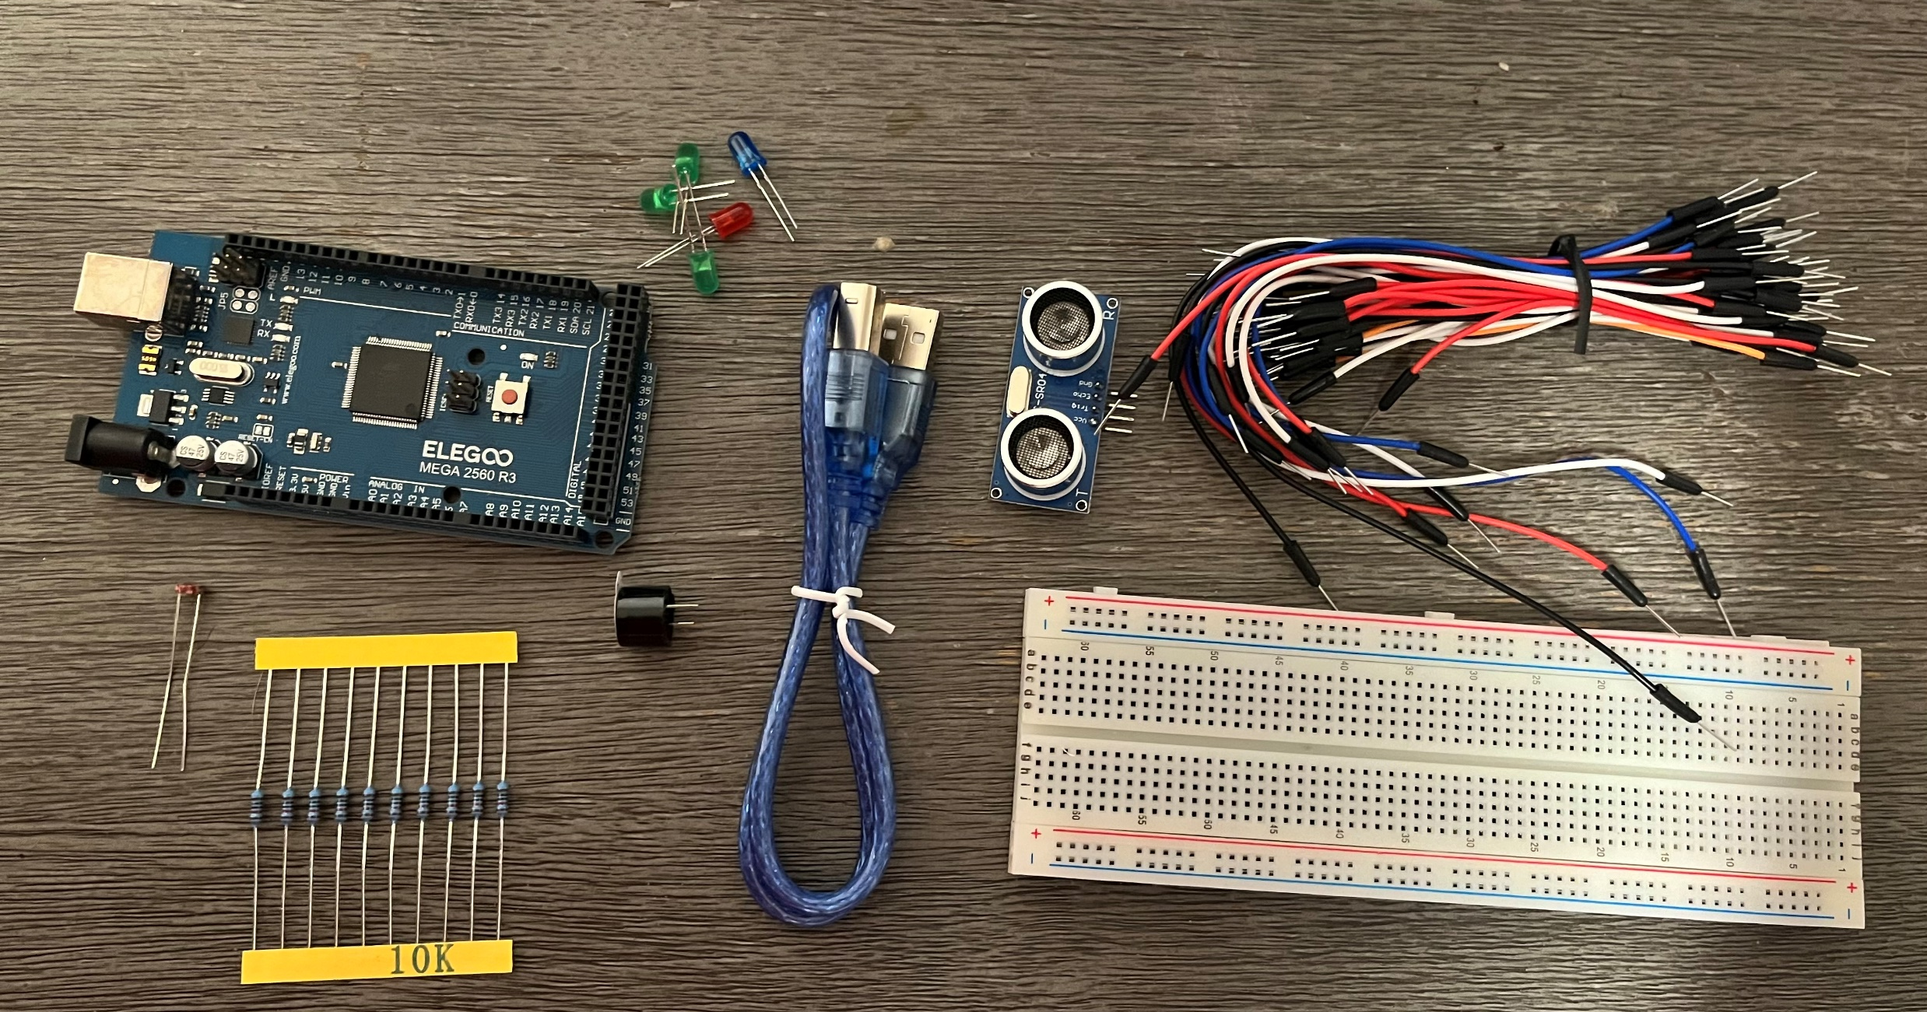
Introduction
In this project, we used the IoT tech core kit to create a home security system simulation programmed by Arduino. In the tech core kit, we used:
Breadboard
Resistor 10kΩ
LEDs
Ultrasonic Sensor
Active Buzzer
Photoresistor
Wires
USB Type B cable

Slide 3
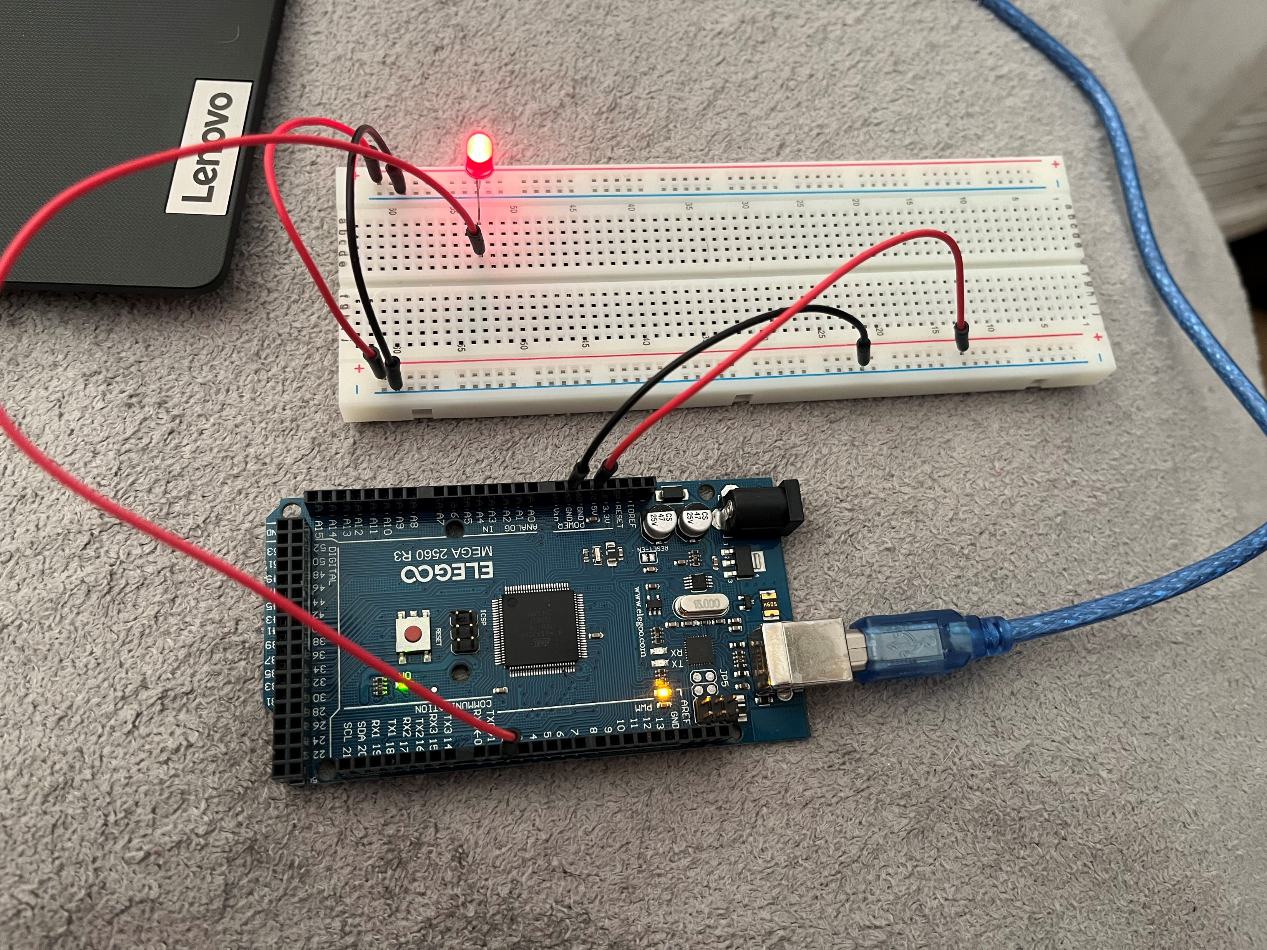
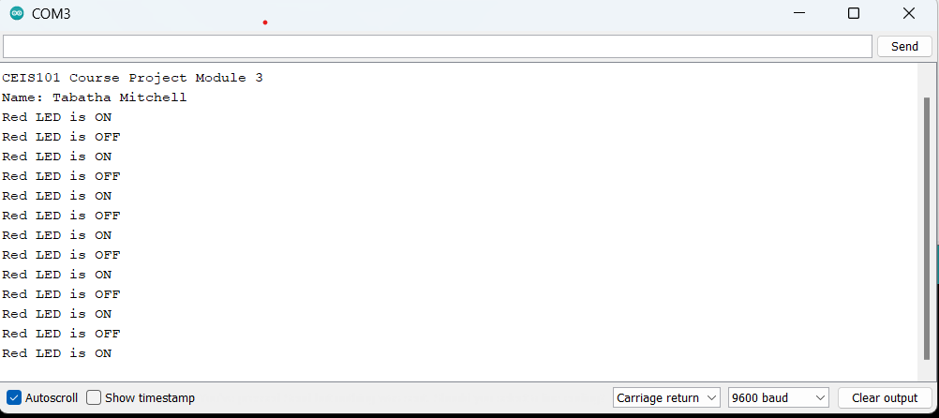
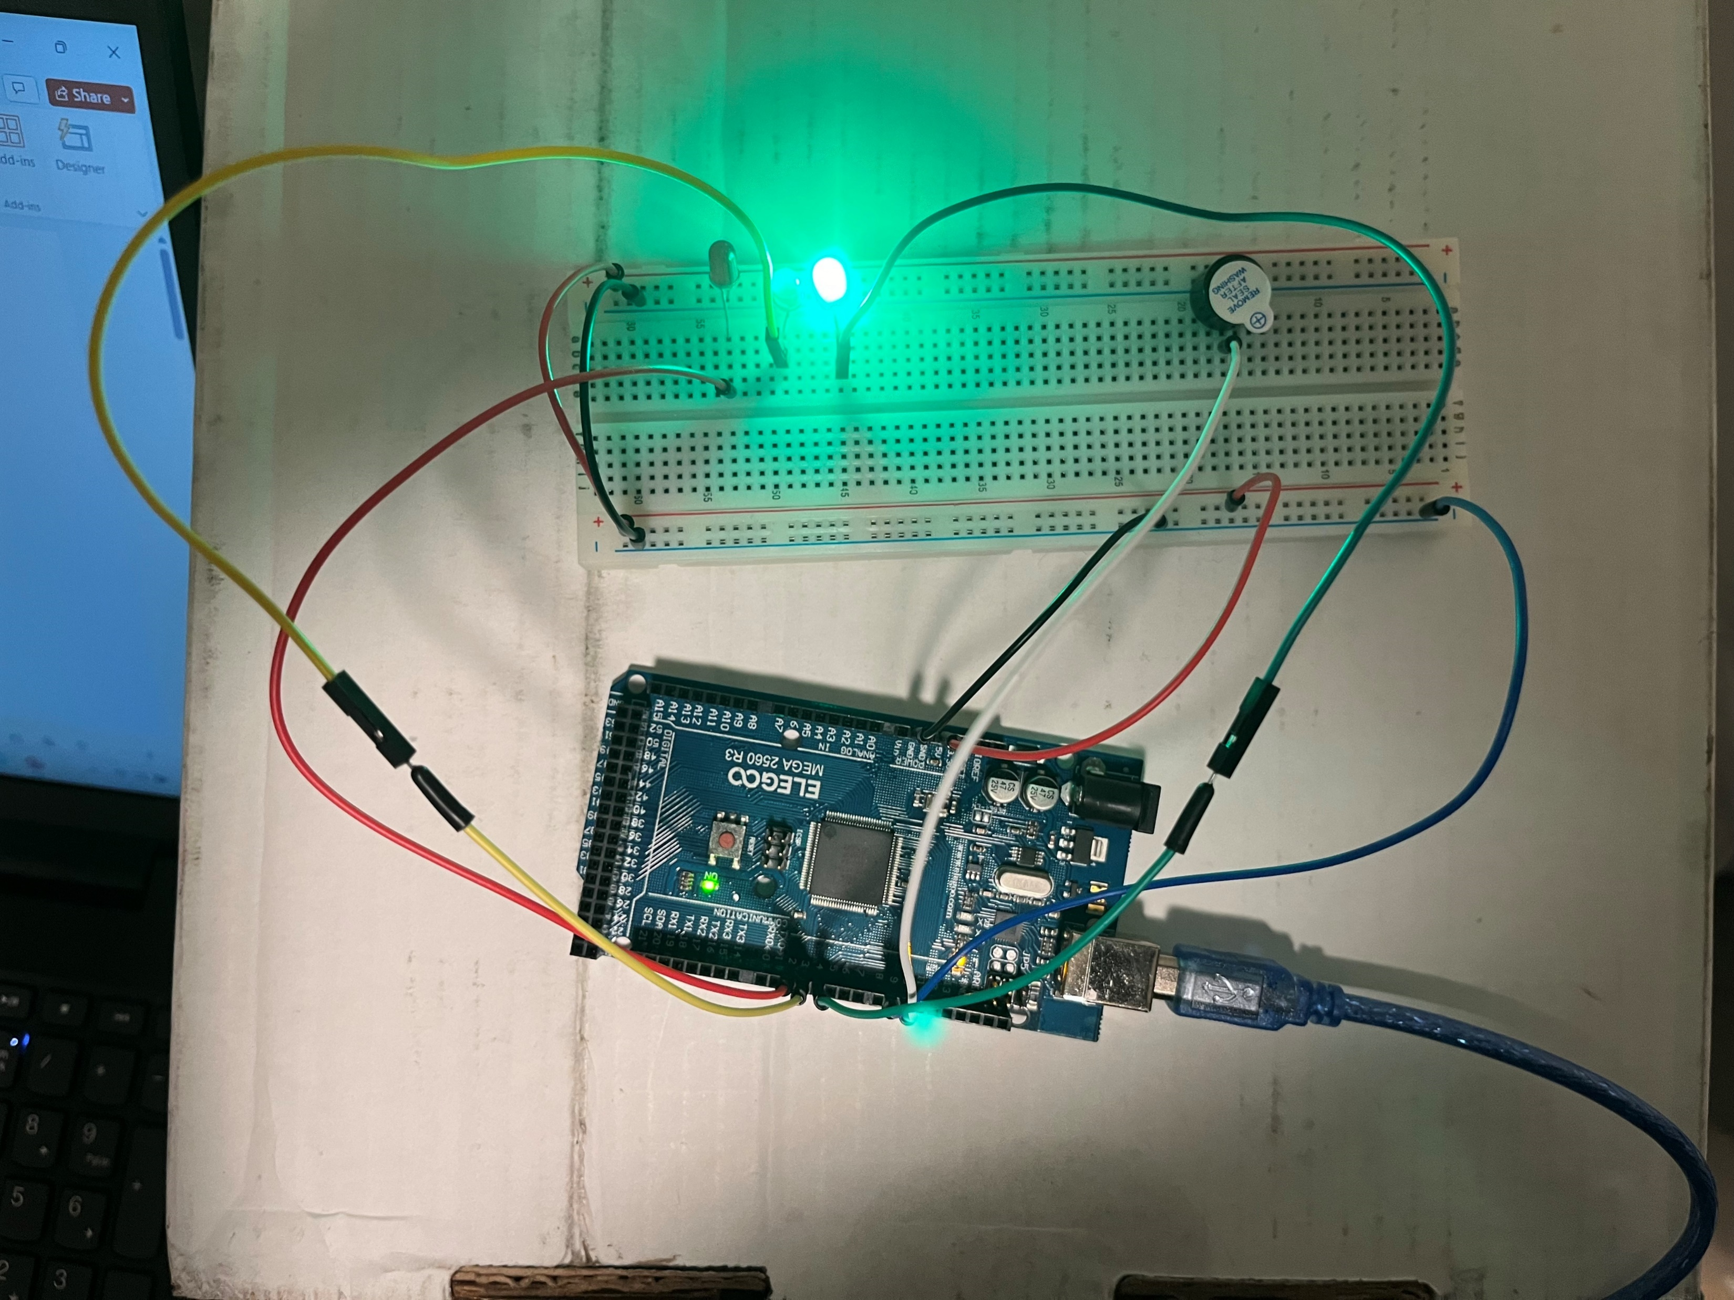
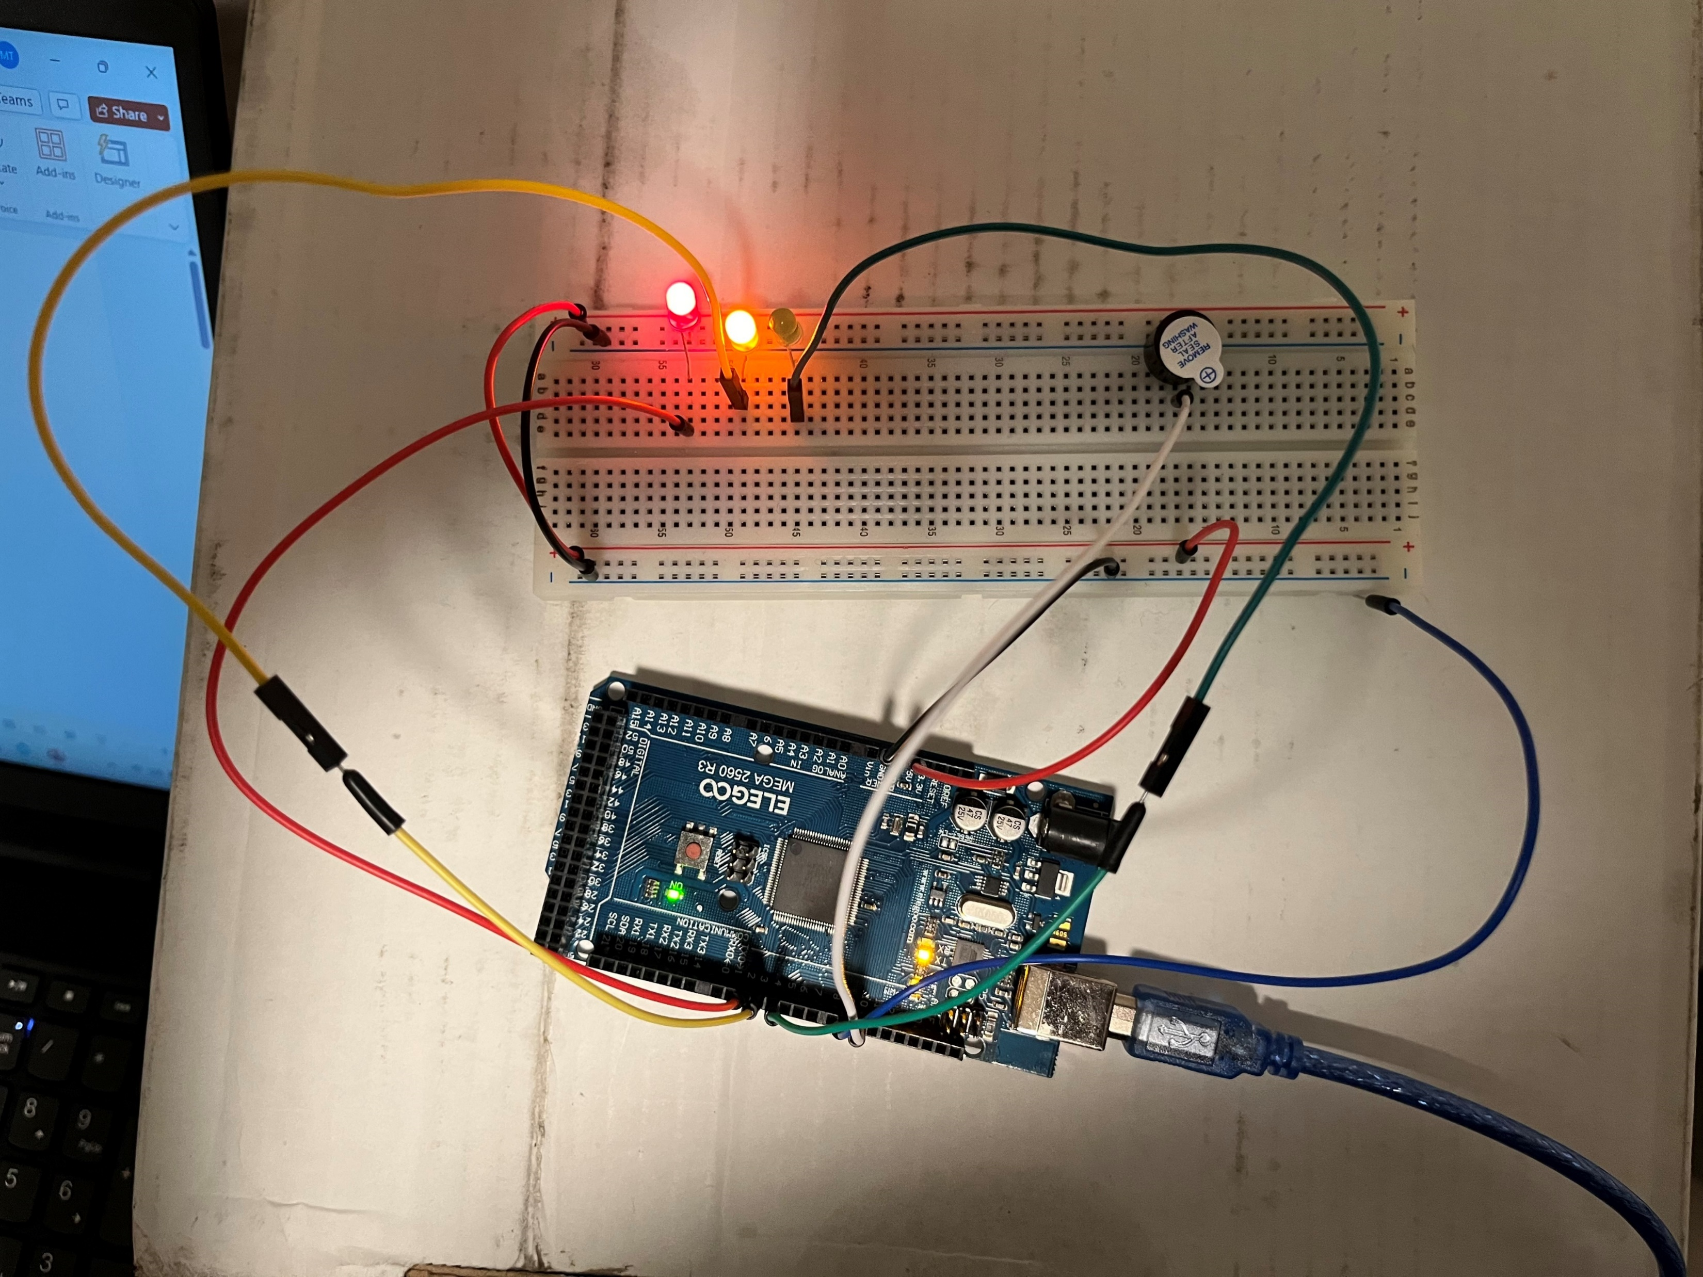
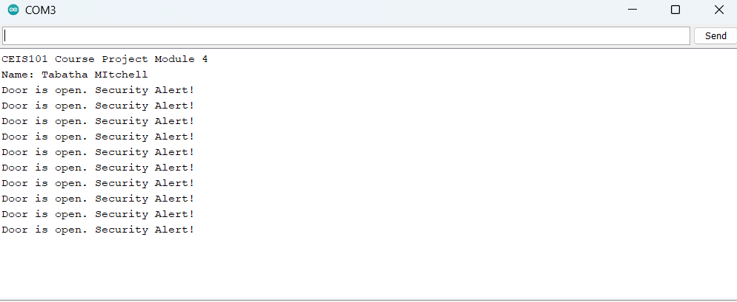
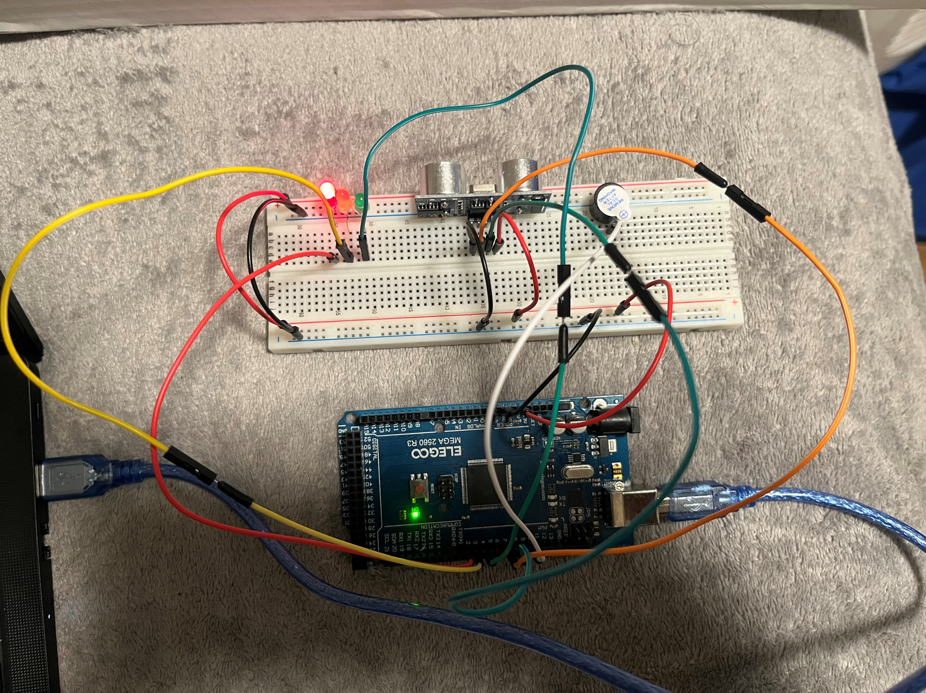
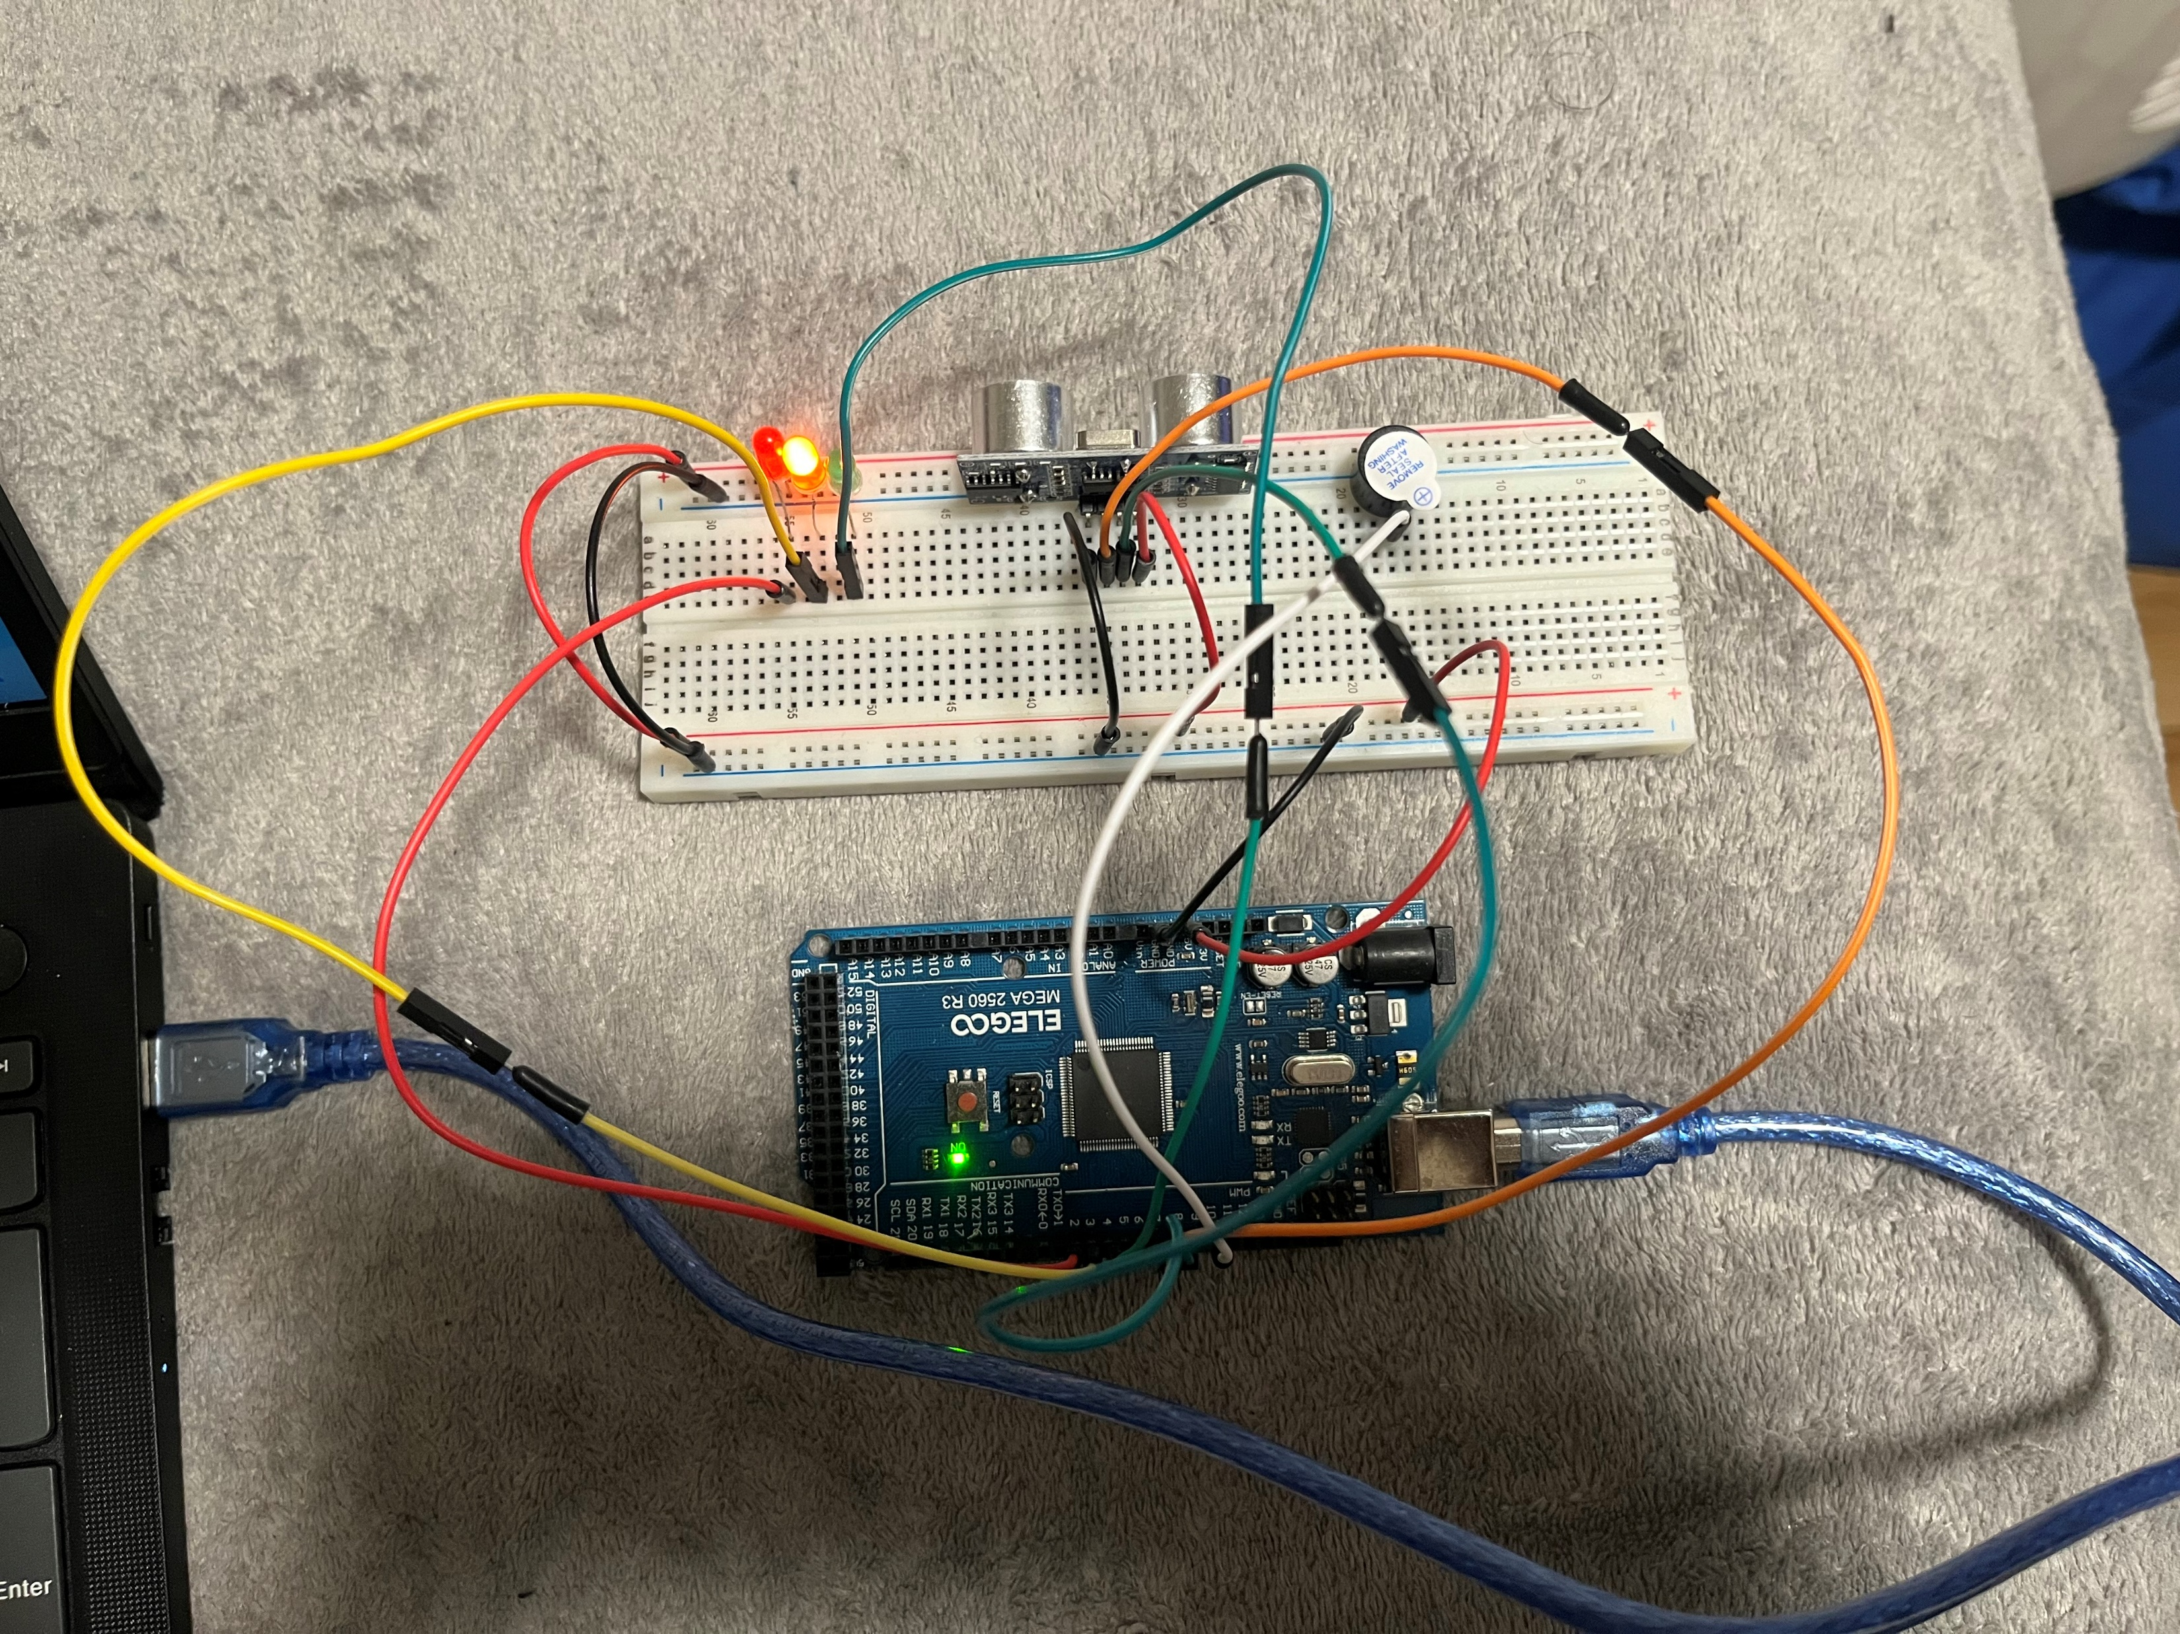
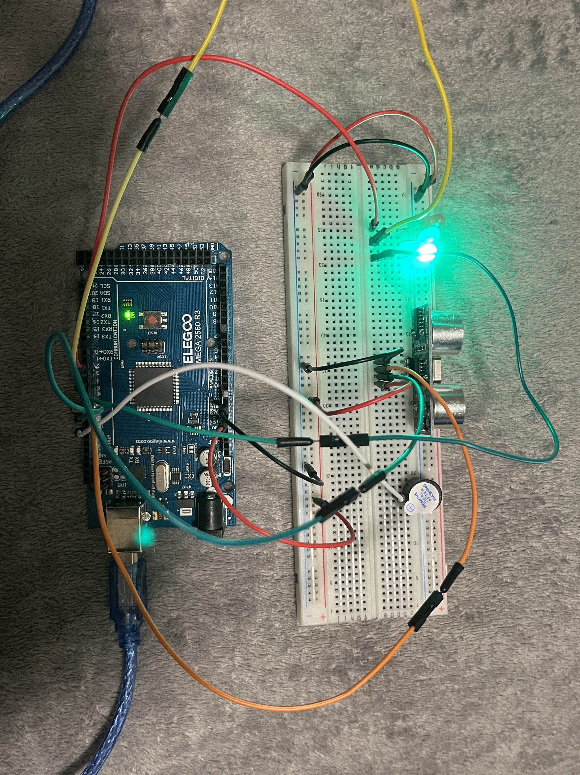
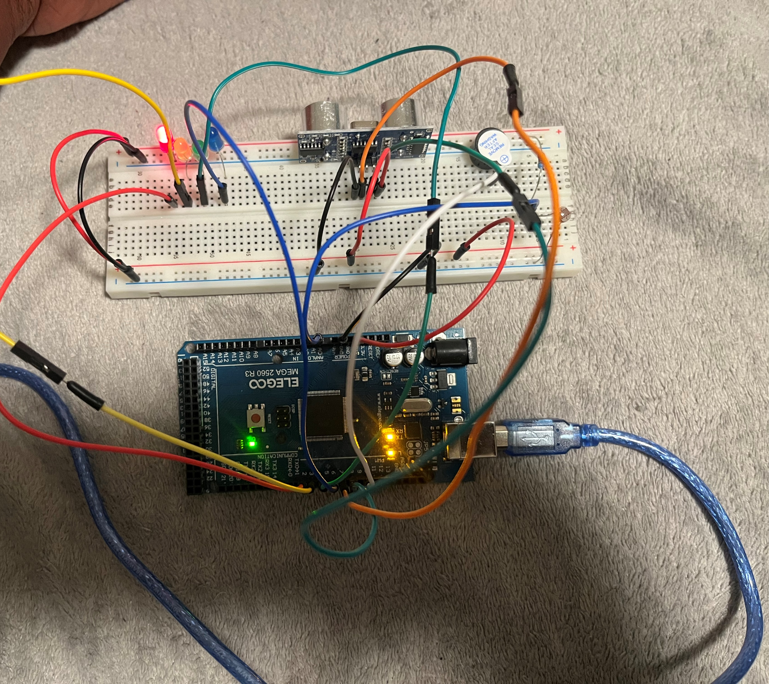
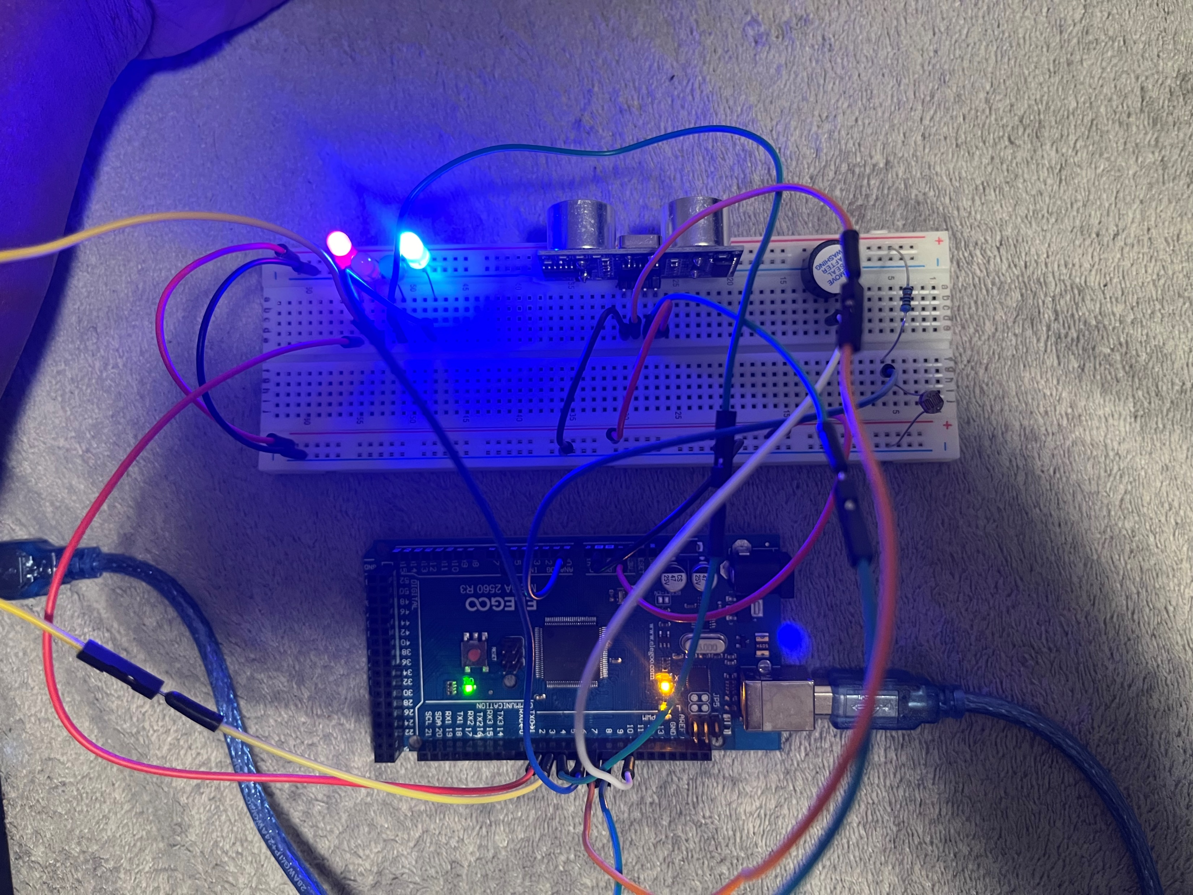
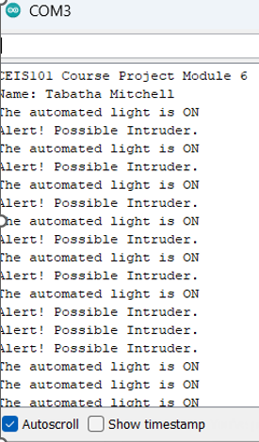
Security System Step-by-Step
I used the IoT kit to turn the red light on and off.
To make this happen I used 5 wires, 1 red LED light,1 breadboard, USB type B cable. Single LED
week 3
This is a security threat with more LEDs added, more wires, and an active Buzzer. This is when the doors open and closes. Door sensor
Week 4
The ultrasonic sensor was added. This tells when you are very close: red light, mid-close: yellow light, and far away: green light. Distance Sensor
Week 5
Photoresistor and Resistor 10kΩ
Added to create a possible intruder alert. Automated Light
Week 6

Slide 4
Challenges/Lessons Learned
Doing this project was very fun and new to me. But everything was explained and very well taught I had no challenges.

Slide 5
Career Skills
I learned how to use Tinkercad and to build using the IoT tech core kit/Mega 2560 board.
I learned how to use Arduino IDE.
I learned how to build an home security system using mega 2560 board.

Slide 6
Conclusion
In class, we created a home security system using Arduino IDE and an IoT tech core kit. In the kit we used: Breadboard, Resistor 10kΩ, LEDs, Ultrasonic Sensor, Active Buzzer, Photoresistor, Wires, USB Type B cable, Mega 2560 board, and laptop/computer. To create this project, we divided it into sections per week. Week 3 we started with a single red LED light on. Week 4 we added a door sensor. Week 5 we added a distance sensor. Week 6 we added an automated light. With every week put together, we made a smart home security system.

Slide 7
References
I used slides, lectures, and notes, also the tests came in handy to double-check check information which is all provided in class.

